Slide 1


23TH INTERNATIONAL SYMPOSIUM NEW TRENDS IN R+D+I IN LITERATURE, LANGUAGE, EDUCATION AND IST. FROM INNOVATION TO CANON
Primary School Entrepreneurship Education: A Holistic Educational Perspective
Enhancing the Empowerment of Young Learners through Innovation and Initiative-Based Learning
Androniki Pantelidou
University of Alicante
Presentation

Slide 2

Why Entrepreneurship in Primary Education?
  Encourages lifelong learning and adaptability
  Prepares students for uncertain futures
  Fosters early problem-solving and leadership skills
  Aligns with global education goals (e.g., SDG 4)
Source: (Bacigalupo et al., 2016; Percy & Hooley, 2023)

Slide 3

Historical Evolution of Entrepreneurial Learning
A step by step process
  From industrial-age education to innovation-driven paradigms
  21st-century competencies redefine educational priorities
  Influence of global education policies (e.g., OECD, EU)
  Entrepreneurship no longer reserved for higher education
Source: (Miço & Cungu, 2023; Browning et al., 2025)

Slide 4

Core Competencies Developed
Enhancing students’ skills in modern curricula
  Creativity and innovation
  Risk assessment and decision-making
  Initiative and leadership
  Collaboration and communication
Source: (De Lourdes Cárcamo-Solís et al., 2017; Browning et al., 2025)

Slide 5
Role of Play and Imagination
  Play-based entrepreneurship encourages exploration
  Dramatic play and role-play simulate economic activities
  Encourages emotional intelligence and empathy
  Safe space for experimentation and failure
Play
Imagination
  exploration
  economic activities
  intelligence
  empathy
  experimentation
Source: (De Lourdes Cárcamo-Solís et al., 2017; “Enhancing Green Career Guidance Systems for Sustainable Futures,” 2024)

Slide 6

Entrepreneurial Education vs. Traditional Economics
Not limited to profit or business
Focuses on value creation in any context
Promotes ethical thinking and sustainability
Nurtures civic engagement and social responsibility
Source: (Gibb, 2002; European Commission/EACEA/Eurydice, 2016)

Slide 7

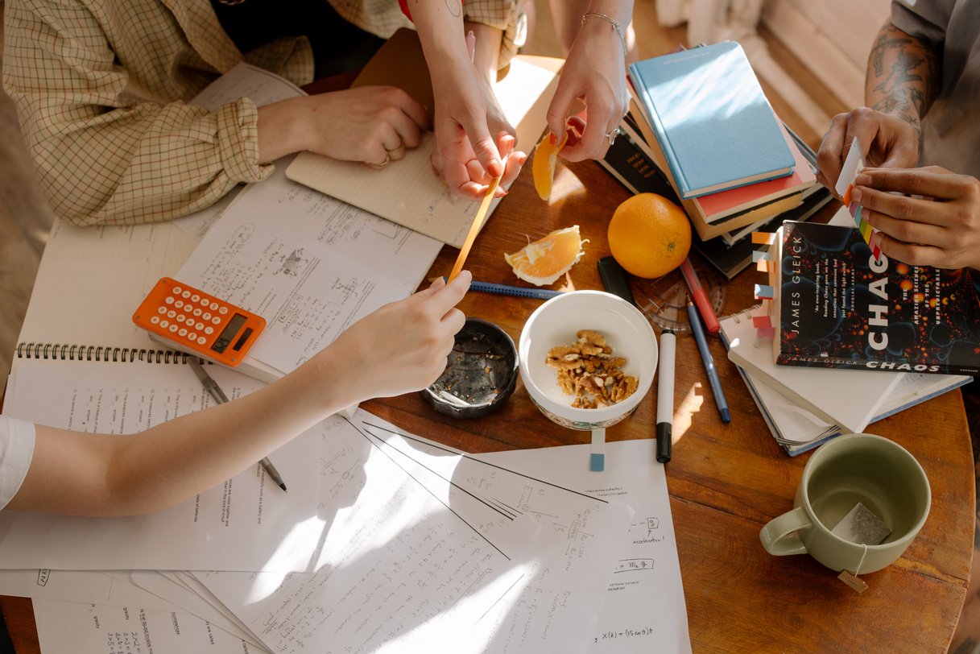


Integration with STEM and the Arts
Encouraging innovation through hands-on STEM projects
Design thinking and maker education as STEAM promotes holistic, creative thinking
Storytelling, performance, and visual arts for pitching ideas
Source: (Gibb, 2002; Hassi, 2016; European Commission/EACEA/Eurydice, 2016)

Slide 8



Assessment and Evaluation Methods
Use of portfolios and self-assessment
Peer feedback and reflective journals
Formative evaluation through projects and prototypes
Source: (Percy & Hooley, 2023; De Lourdes Cárcamo-Solís et al., 2017)

Slide 9
Teacher as Facilitator
From instructor to coach/mentor
Professional development in entrepreneurial pedagogy
Empowering teachers to take creative risks
Need for continuous support and training
Source: (Daniel & Makdisi, 1984; “Enhancing Green Career Guidance Systems for Sustainable Futures,” 2024)

Slide 10
Equity and Inclusion in Entrepreneurial Education
  Adapting approaches for diverse learners
  Empowering underrepresented groups
  Culturally relevant examples and inclusive role models
  Accessibility through differentiated instruction
Source: (De Lourdes Cárcamo-Solís et al., 2017; Daniel & Makdisi, 1984)

Slide 11
Community Partnerships and Real-World Learning
  Collaborations with local businesses and NGOs
  Field trips, mentorships, and guest speakers
  Family and community involvement in school markets
  Creating value beyond the classroom
Source: (European Commission/EACEA/Eurydice, 2016; Browning et al., 2025)

Slide 12
Technology and Digital Entrepreneurship
Digital storytelling, e-commerce simulations, coding Safe exploration of online platforms | Introduction to basic financial literacy tools Gamified learning apps (e.g., virtual marketplaces)
Source: (European Commission/EACEA/Eurydice, 2016; Browning et al., 2025)

Slide 13
Global Case Studies
Finland: Entrepreneurial mindset across curriculum
Mexico: “My First Enterprise” success model
Morocco: Skills through community engagement
Australia: Inquiry-based innovation programs
Source: (De Lourdes Cárcamo-Solís et al., 2017; Browning et al., 2025)

Slide 14
Future Directions
Cross-sector collaboration in education
National policies to support early entrepreneurship
Integration with climate and sustainability education
Building a generation of ethical changemakers

Slide 15
Conclusions
Early entrepreneurship nurtures engaged, capable citizens
Teachers and schools must be empowered as innovators
A shift in mindset is required across education systems
Let’s rethink what children are capable of — and support them

Slide 16

  Bacigalupo, M., Kampylis, P., & Van Den Brande, G. (2016). ENTREComp: The Entrepreneurship Competence Framework. European Commission. Retrieved May 21, 2025, from https://joint-research-centre.ec.europa.eu/entrecomp-entrepreneurship-competence-framework_en
  Browning, Robert, Arnove, F, R., Swink, Lee, R., Ipfling, Heinz-Jürgen, Nakosteen, K, M., Graham, F, H., Marrou, Henri-Irénée, Thomas, Murray, R., Shimahara, Nobuo, Moumouni, . . . Zoraida, J. (2025, May 1). Education | Definition, Development, History, Types, & Facts. Encyclopedia Britannica. Retrieved May 2, 2025, from https://www.britannica.com/topic/education/Europe-in-the-Middle-Ages
  Daniel, N., & Makdisi, G. (1984). The rise of colleges. institutions of learning in Islam and the West. Journal of the American Oriental Society, 104(3), 586. https://doi.org/10.2307/601679
  De Lourdes Cárcamo-Solís, M., Del Pilar Arroyo-López, M., Del Carmen Alvarez-Castañón, L., & García-López, E. (2017). Developing entrepreneurship in primary schools. The Mexican experience of “My first enterprise: Entrepreneurship by playing.” Teaching and Teacher Education, 64, 291–304. https://doi.org/10.1016/j.tate.2017.02.013
  Enhancing green career guidance systems for sustainable futures. (2024). In OECD Education Working Papers. https://doi.org/10.1787/e6ad2d9c-en
  European Commission/EACEA/Eurydice. (2016). Entrepreneurship Education at school in Europe. Eurydice Report. Luxembourg: Publications Office of the European Union. https://doi.org/10.2797/301610
  Gibb, A. (2002). Creating conducive environments for learning and entrepreneurship. Industry and Higher Education, 16(3), 135–148. https://doi.org/10.5367/000000002101296234
  Hassi, A. (2016). Effectiveness of early entrepreneurship education at the primary school level: Evidence from a field research in Morocco. Citizenship Social and Economics Education, 15(2), 83–103. https://doi.org/10.1177/2047173416650448
  Miço, H., & Cungu, J. (2023). Entrepreneurship Education, a Challenging Learning Process towards Entrepreneurial Competence in Education. Administrative Sciences, 13(1), 22. https://doi.org/10.3390/admsci13010022
  Percy, C., & Hooley, T. (2023). Lessons for career guidance from return-on-investment analyses in complex education-related fields. British Journal of Guidance and Counselling, 52(3), 503–521. https://doi.org/10.1080/03069885.2023.2186372
References

