Slide 1

Venice & Florence as Points of Contact
Between Byzantium & the Renaissance West
An Analysis of Intellectual Synthesis, Refugee Flows, and the Transmission of Classical Heritage (1261–1453)

Slide 2
Introduction & Context
The geopolitical retreat of Byzantium and the cultural bridge to Italy

Slide 3

The Late Palaiologan Dynasty
Geopolitical & Financial Crisis
A Cultural Powerhouse
Following the recovery of Constantinople in 1261, the Empire faced severe structural struggles. Weakened militarily and exhausted financially, Byzantium was plagued by deep civil wars and domestic ecclesiastical disputes such as the Hesychast controversy.
Despite territorial shrinkage to a few pockets—Constantinople, Mystras, and Aegean islands—Byzantium retained immense diplomatic and intellectual authority. A spectacular scholarly revival, the Palaiologan Renaissance, flourished alongside political decline.

Slide 4
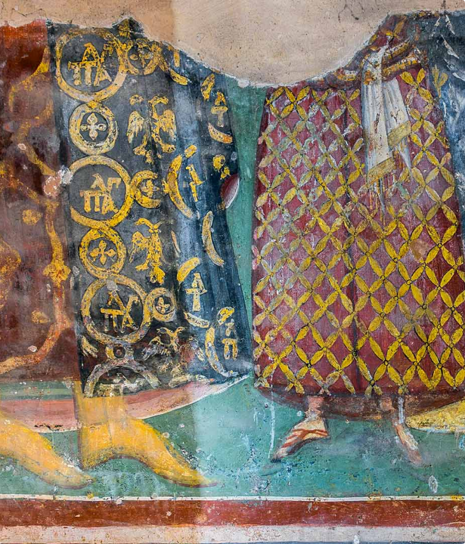
The Palaiologan Renaissance
Coinciding with the early stages of the Western Renaissance, late Byzantine society experienced a profound intellectual reawakening. Centered in Constantinople, Thessaloniki, and the Peloponnese, scholars engaged in rich philosophical inquiry.
This movement witnessed a rigorous re-examination of Classical Greek texts and a striking development in late Byzantine painting and mosaics, serving as a powerful intellectual beacon for neighboring Italy.

Slide 5






Catalysts of Intellectual Synthesis
Scholarly Migration
Ferrara-Florence
The Crisis of 1453
Fleeing deteriorating security, many Greek scholars began migrating to major Italian cities as early as the Latin conquest of 1204, searching for intellectual freedom and patronage.
The ecumenical Council of 1438–1439, aimed at theological union, gathered hundreds of intellectual leaders, creating an unprecedented arena for mutual philosophical dialogue.
The tragic final fall of Constantinople triggered a crucial diaspora of refugees, who safely transported priceless classical Greek codices to Western centers of learning.

Slide 6
Bridges of the Renaissance
Analyzing the distinct socio-economic paths of Venice and Florence

Slide 7
Socio-Economic Foundations
Break from Feudal Structure
The Republican Mirror
Both Venice and Florence achieved immense wealth by abandoning traditional feudalism. Instead, they forged highly organized oligarchic regimes controlled by ambitious merchant guilds, elite trade syndicates, and powerful banking dynasties.
Desiring to legitimize their influence, both states styled themselves as 'Republics'. They actively drew political inspiration from the classical antiquity of Rome and Greece, fostering the perfect soil for the Renaissance to blossom.

Slide 8

The Long-standing Ties of Venice
A Byzantine Outpost: Founded in the 6th century, Venice originally operated as a direct province of the Byzantine Empire, securing crucial protection.
Commercial Expansion: In the 10th century, Emperor Basil II issued a Golden Bull granting Venice unparalleled merchant rights, followed by deeper trade immunity from Alexios I Komnenos.
A Complex Alliance: These commercial monopolies paved the way for Venetian colonial dominance in the Mediterranean, while creating friction due to intense commercial rivalry.

Slide 9
Byzantine-Venetian Evolution
10th Century
11th Century
1204
Post-1261
Golden Bull of Basil II establishes earliest commercial privileges in Constantinople.
Golden Bull of Alexios I consolidates Venice as a major military ally and commercial partner.
The Fourth Crusade shifts Venice from ally to conqueror, capturing three-eighths of the Capital.
Continuous Venetian control in Greek lands sparks deep intellectual and artistic exchange.

Slide 10

The Cultural Plunder of 1204
The Latin sack of Constantinople in 1204 transformed Venetian public space. Vast cultural and material riches were systematically looted and shipped to Venice to ornament public buildings.
Priceless manuscripts, architectural spoils, religious icons, and ancient bronze sculptures were integrated into the fabric of the Venetian Republic, inadvertently planting the early seeds of classical Renaissance studies.

Slide 11
Venetian Cultural Osmosis
Living Diaspora Links
Scholarly Influx
Venice's ongoing territorial control over Greek islands and maritime ports fueled a steady migration of Greek merchants, artists, and sailors to the Venetian lagoon. This established a robust, active diaspora community of over 5,000 members.
From the mid-14th century onward, a critical wave of prominent Byzantine scholars arrived in Venice. Seeking intellectual security, they transformed the city into a prominent center for the study of the classical Greek language.

Slide 12


Florence: Cradle of Early Humanism
Dynamic Civic Patronage
Unlike Venice's maritime trade network, Florence's early Renaissance was driven by deliberate artistic and academic patronage. Shifting from oligarchy to dynastic lordship, ruling families like the Medici sought to legitimize their rule by actively sponsoring scholars.
This vibrant environment attracted brilliant Byzantine intellectuals, who introduced authentic classical Greek texts directly to Western Europe's most famous universities.

Slide 13



Byzantine Teachers in Florence
Manuel Chrysoloras
John Argyropoulos
D. Chalkokondyles
Invited by the Medici in 1396, he introduced authentic Greek studies to Florentine classrooms, pioneering the modern model of humanist education in the West.
An eminent philosopher who taught in Florence, providing masterful translations of Aristotle and Plato's Republic while popularizing Byzantine pedagogy.
An elite scholar who taught Greek classics to the Medici court, facilitating the publication of early printed editions of ancient epics.

Slide 14

The Humanist Reorientation
"While medieval scholasticism restricted classical philosophy to the service of theology, Italian Humanism sought the original texts to revive human intellect, personal liberty, and active civic duty."
— ON THE RISE OF RENAISSANCE HUMANISM

Slide 15
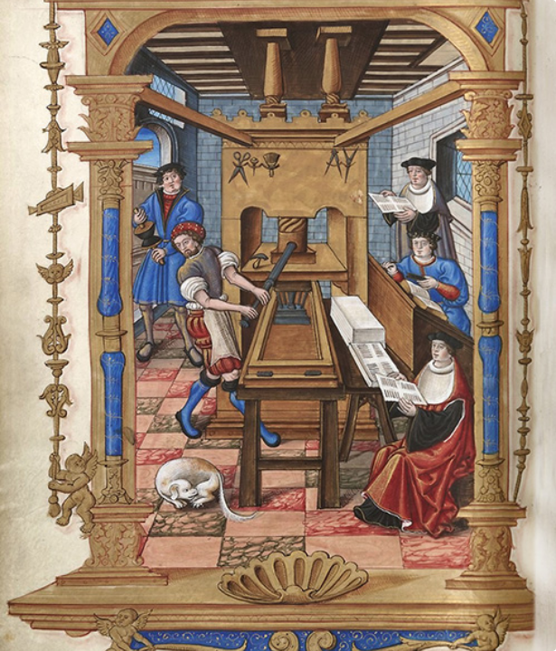
Venice: Capital of the Printed Word
The invention of moveable type transformed the preservation of classical heritage. Seeking to commercialize rare books, Venice quickly emerged as Europe's preeminent printing hub.
The renowned Aldine Press, founded by Aldus Manutius, became a vibrant gathering place for Greek scholars like Marcus Musurus, who meticulously edited, proofread, and published the first printed editions of ancient Greek masterpieces.

Slide 16
The Palaiologan Renaissance
An assessment of late Byzantine cultural and philosophical vigor

Slide 17
The Late Byzantine Rebirth
Reclaimed Hellenic Identity
Vibrant Scholarly Networks
As the multi-ethnic empire collapsed, Byzantine cultural consciousness evolved. The intelligentsia turned away from imperial ecumenicism, re-centering their identity around Hellenic language, classical literature, and ancient heritage.
Despite economic hardship, over 150 secular and monastic scholars maintained active epistolary networks across cities like Constantinople and Mystras, copying and saving ancient codices under the patronage of wealthy elites.

Slide 18




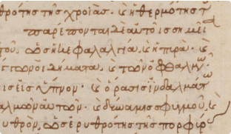

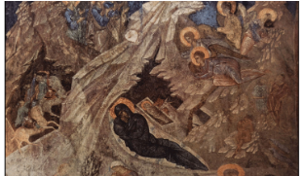
Facets of Palaiologan Inquiry
Philology & Commentary
Natural Sciences
Artistic Zenith
Meticulous copying, editing, and comprehensive commentary on the texts of ancient Greek poets and dramatists.
Renewed mathematical and astronomical research led by pioneering scholars like Metochites, Planudes, and Gregoras.
Pioneering expressive naturalism in late Orthodox frescoes, directly influencing early proto-Renaissance painters in Italy.

Slide 19
Radical Thinkers of Byzantium
Theodore Metochites
George Gemistos Plethon
A brilliant prime minister and polymath who questioned the absolute primacy of the Byzantine state. He advocated for critical empirical observation, scientific inquiry, and translated complex works of classical mathematics.
A highly radical philosopher who proposed a complete reorganization of Byzantine society. Drawing heavily on Platonic thought, he envisioned an idealized, pagan-inspired state that challenged both Orthodox dogma and political structures.

Slide 20
The Council of Ferrara-Florence
The convergence of Eastern and Western thought in the shadow of crisis

Slide 21

The Geopolitical Union Quest
Desperate Search for Aid
The Imperial Delegation
Facing aggressive Ottoman encirclement, Emperor John VIII Palaiologos sought to negotiate an ecclesiastical union with Rome, hoping to inspire a powerful Western military crusade to defend Constantinople.
In 1438, a historic 700-member delegation traveled to Italy, bringing together elite theological minds, including the Emperor, Patriarch Joseph II, Bessarion of Nicaea, Mark Eugenikos, and Gemistos Plethon.

Slide 22
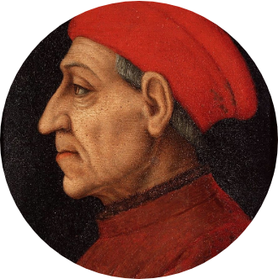
Plethon & the Platonic Academy
Unlocking Platonic Thought
While attending the Council, Gemistos Plethon gave highly influential public lectures on the metaphysics of Plato. These brilliant sessions sparked a fascination with Neo-Platonism among Florence's elite intellectual circles.
His teachings profoundly inspired Cosimo de' Medici to establish the renowned Florentine Platonic Academy in 1462, under the brilliant direction of Marsilio Ficino.

Slide 23

Cardinal Bessarion's Bridge
Following the Council, Bishop Bessarion embraced Catholicism and rose to become a cardinal in the Roman Church. He dedicated his life to reconciling Plato and Aristotle while offering safety to Greek refugees.
Bessarion amassed a vast collection of rare Greek manuscripts, which he bequeathed to Venice, creating the foundation of the world-renowned Marciana Library—honoring Venice as a "second Byzantium."

Slide 24

Venice & Florence Compared
Key Aspect | The Republic of Venice | The Republic of Florence
Primary Channels | Centuries of trade, Byzantine conquest (1204), and mass migration. | Generous intellectual patronage, academic chairs, and the 1439 Council.
Key Greek Scholars | Marcus Musurus, Cardinal Bessarion. | Manuel Chrysoloras, Gemistos Plethon, John Argyropoulos.
Scholarly Medium | Manuscript preservation, translation circles, and commercial printing. | Platonic philosophy, classical education models, and humanism.
Lasting Monuments | The Marciana Library, early Aldine printed Greek editions. | The Florentine Platonic Academy, rich Medici library collections.

Slide 25
Conclusions
Evaluating the enduring legacy of the Byzantine intellectual transmission

Slide 26
Intellectual Legacies
The Italian Renaissance was not an isolated event; it was profoundly shaped by the preservation and transmission of classical scholarship from Byzantium. Through Venice and Florence, the wisdom of Greece returned to the West, changing European culture forever.

