Slide 1
Bridging the Gap: Transitioning from Segregated Special Units to Inclusive Classrooms in Greece
Vasiliki Theochari– PhD candidate, Alicante University,
Conference La Nucia 2026

Slide 2
The Research Problem
The Greek Dual System
Despite international trends towards full inclusion, Greece maintains a strong parallel system of Special Educational Units (SMEAE) alongside mainstream schools.
This creates a tension between the "medical model" of segregated expertise and the "social model" of universal inclusion.
The Inclusion
The Salamanca Statement and UN CRPD demand a transition that is often hindered by systemic inertia and centralized administrative structures.
Legislative vs. Practical Readiness
Structural vs. Cultural Integration

Slide 3



Theoretical Framework
Medical Model
Focus on individual deficits and diagnosis-based placement in SMEAE units. Focus on "treatment" rather than adaptation.
Social Model
Disability as a result of societal ba rriers. Emphasis on removing environmental and pedagogical obstacles in the classroom.
Inclusion Focus
Transforming the school unit into a flexible ecosystem that serves all lea rners rega rd less of diagnosis or difficulty.

Slide 4
Legislative Evolution in Greece
Law 2817/2000
Foundation of KEDASY and the first formalization of Special Education as a distinct public service.
Redefined and categorize disabilities.
Emphasized integration but kept SMEAE central to the system.
Law 3699/2008
Introduction of PEKES and restructure of support services towards interdisciplinary assessment
Law 4547/2018
Law 4823/2021
Current framework: KEDASY and SDEY roles-Shift towards "Quality Supervisors" and cluster-based support.

Slide 5
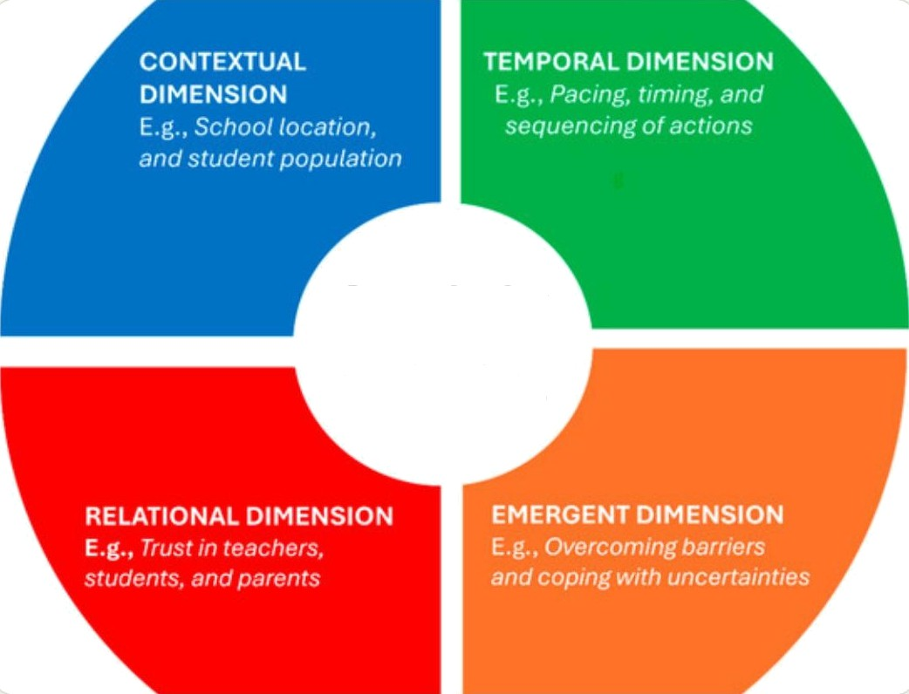
Administration of S M E AE Units
Role of Educational Leadership
Principals of Special Units act as both administrative managers and pedagogical coordinators.
Complexit y I n School Leadership
Key Administrative Challenges
High levels of centralization and bureaucratic rigidity
Limited coordination with general education school clusters
Inequitable allocation of resources, particularly in the management of paraprofessional staff

Slide 6
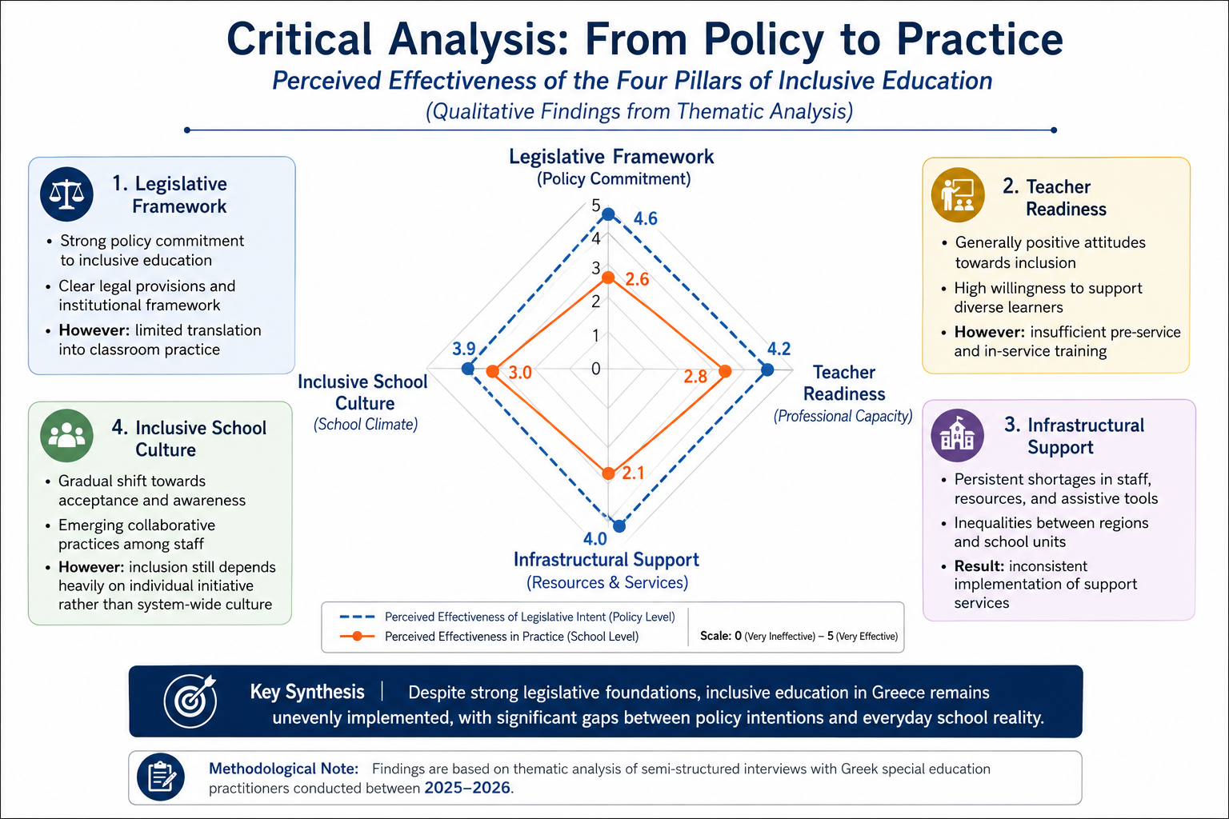

Slide 7
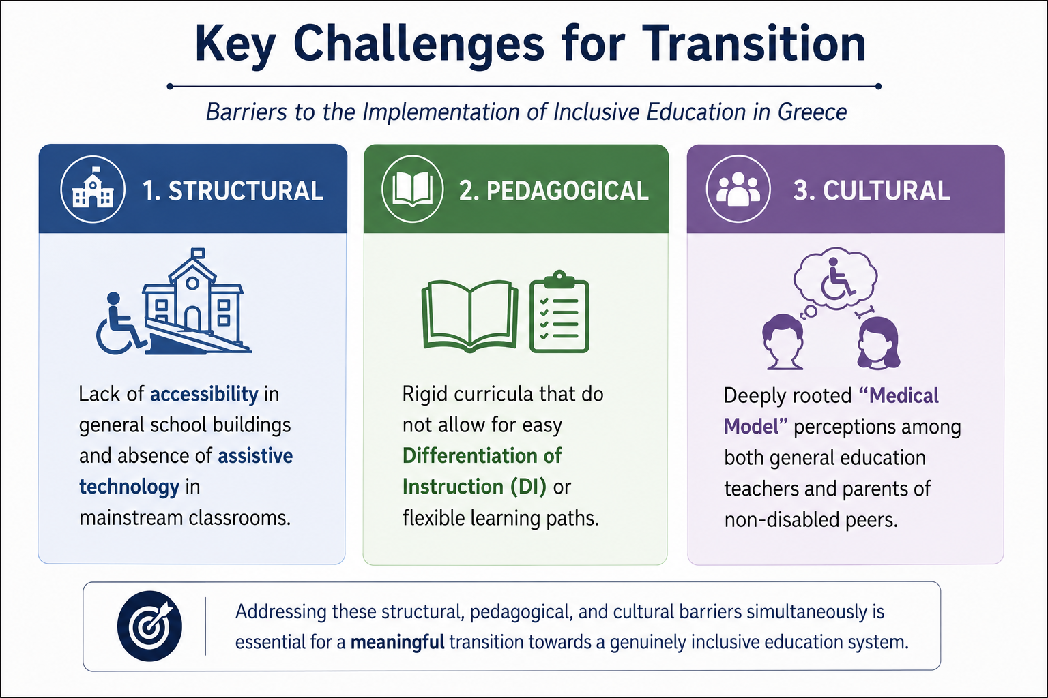

Slide 8
Stakeholder Voices on SEUs and Inclusion
Policy
Practice
The Gap
Inclusive Education Framework
90% of legislation supports inclusion
Strong policy discourse on equity
European alignment with inclusive models
Current School Reality
68% of students with severe SEN in SMEAE
Persistent segregated structures
Administrative rather than pedagogical change
A system that integrates administratively
but
not pedagogically
.

Slide 9
Inclusion is a systemic transformation, not a set of isolated interventions.
Proposed Strategies for a Systemic Transition Toward Inclusive Education
🏫 Decentralized Administration
Greater school autonomy
Pedagogical decision-making at school level
Flexible allocation of support resources
🧑‍🏫 Horizontal Professional Development
Compulsory training for general education staff
Differentiated instruction & neurodiversity
Strengthening inter-school collaboration
♿ Universal Design for Learning (UDL)
Accessibility embedded in curriculum design
Proactive inclusion (not reactive adaptation)
Multiple means of engagement, representation, expression
🗣️ Social Dialogue & Public Awareness
Reducing stigma of “special education” labeling
Inclusive language campaigns
Strengthening community engagement

Slide 10

Towards an “All-One” School
The successful transition to inclusive education in Greece requires moving beyond the critical analysis of obstacles toward a collective reimagining of educational leadership.
Inclusion is not a project. It is a fundamental shift in the democratic DNA of our educational system.

Slide 11
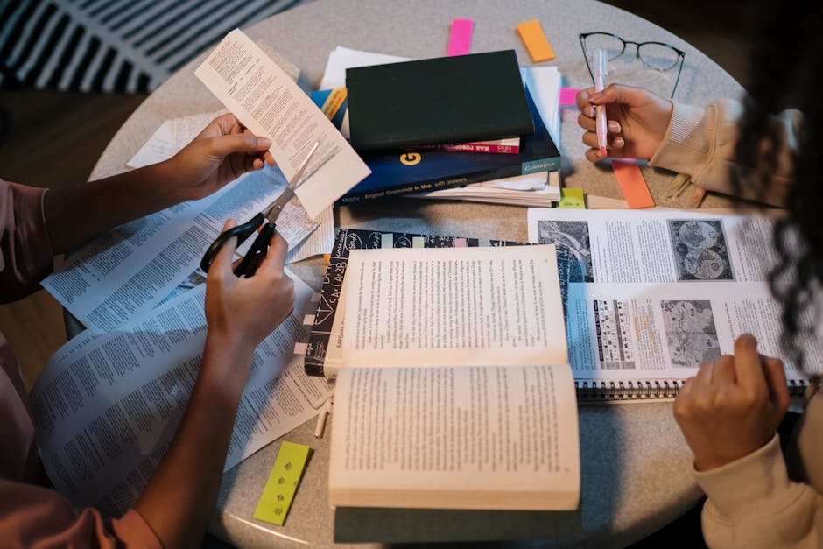
References
1. Ainscow, M. (2020). Promoting Inclusion and Equity in Education. Nordic Journal of Studies in Educational Policy.
2. Florian, L. & Black-Hawkins, K. (2011). Exploring Inclusive Pedagogy. British Educational Research Journal.
3. Damanakis, M. (2018). Administration and organization of school units.
4. Υπουργείο Παιδείας (2021). Νόμος 4823/2021 – Αναβάθμιση Σχολείων.
5. Chatzisotiriou, A. (2017). The training of people with disabilities in Greece.
6. European Agency for Special Needs and Inclusive Education (2022). Country Policy Review: Greece.
7. Darmody, M., Smyth, E., & Banks, J. (2021). Education and Covid-19. Irish Educational Studies.
8. Vlachou, A., Eleftheriadou, D., & Roka, O. (2022). Supporting Students with SEN in Greece.
9. UNESCO (2020). Inclusion and Education: All Means All.

Slide 12
Reflections & dialogue
What role should SEUs play in the future of inclusive education in Greece?
Thank You – Open for Discussion
We welcome your questions, insights, and experiences regarding the evolving role of SEUs. Your perspective will help shape a more inclusive path forward.

