Slide 1
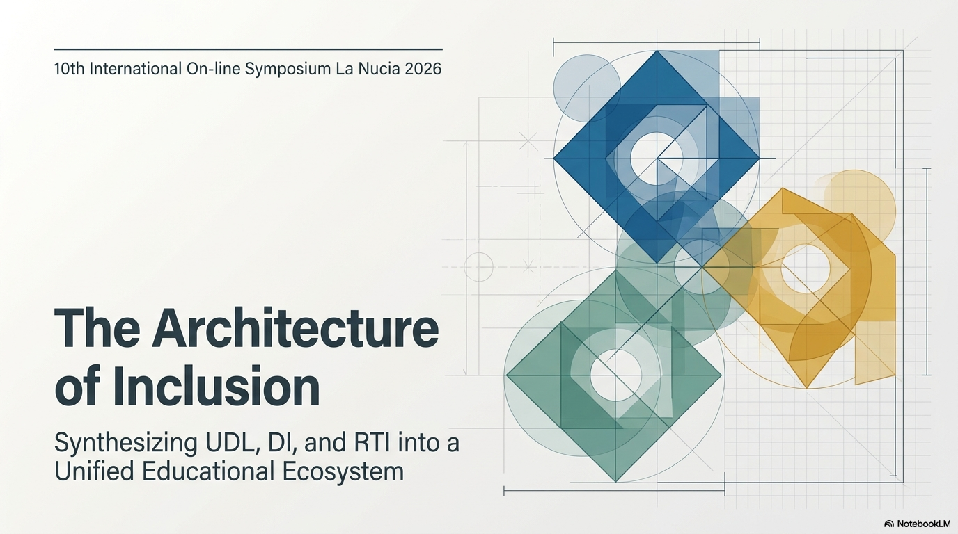
Author : Ioanna Metaxopoulou, student, University of Alicante

Slide 2
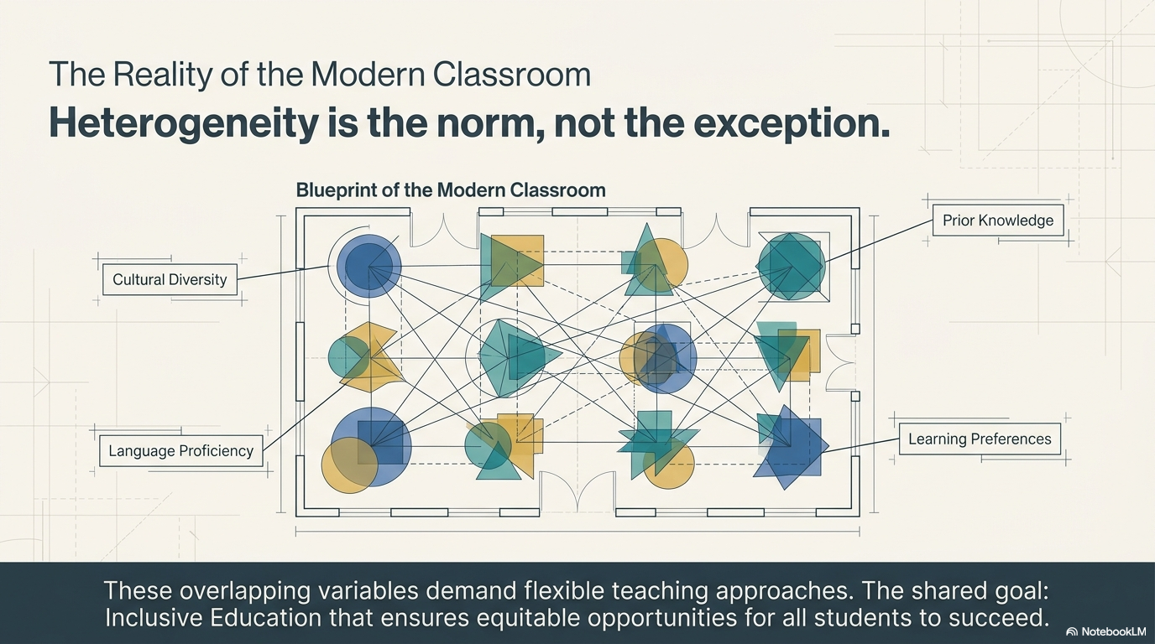

Slide 3


Slide 4
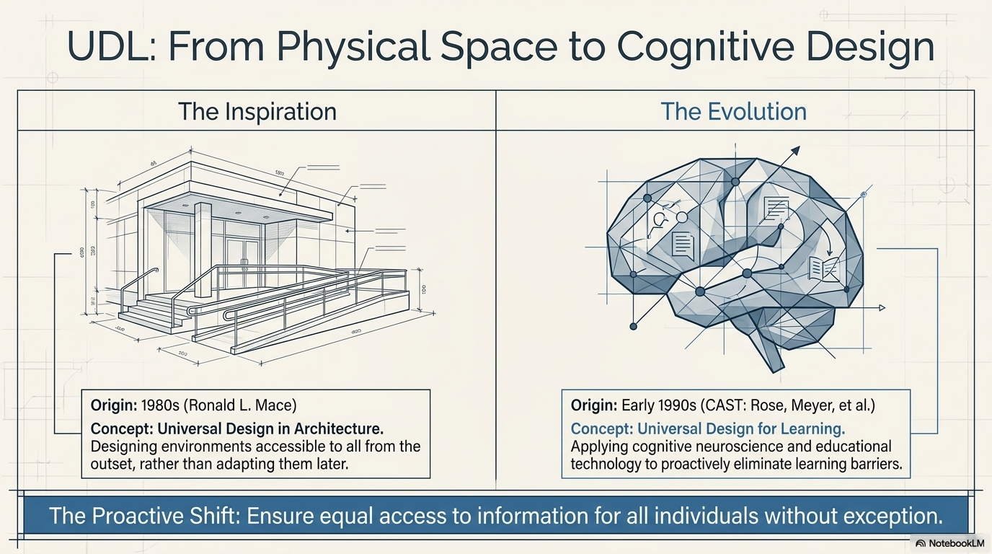

Slide 5
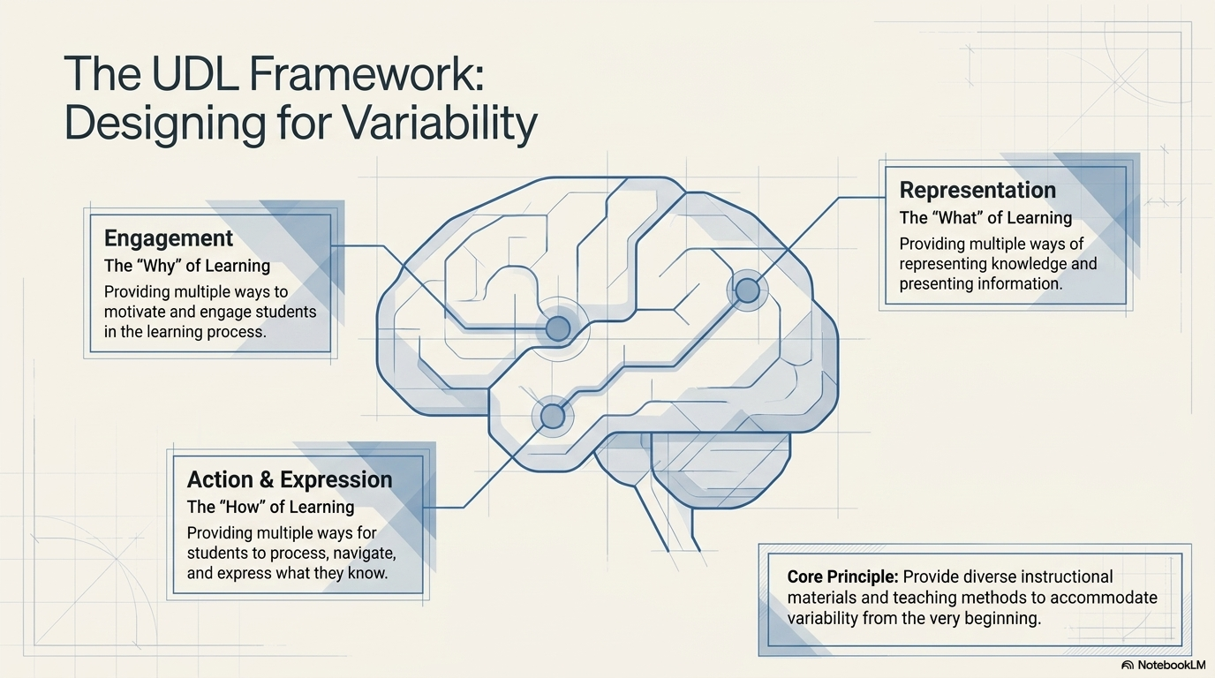

Slide 6
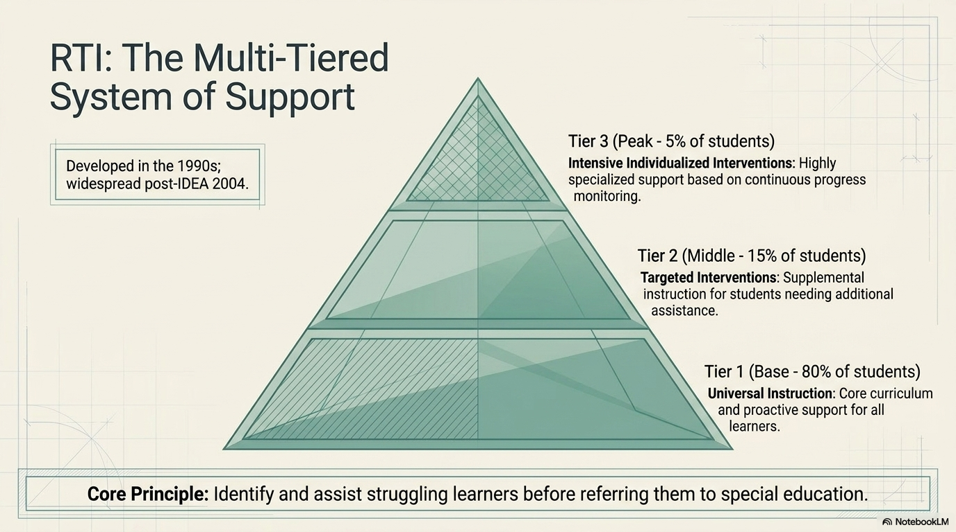

Slide 7
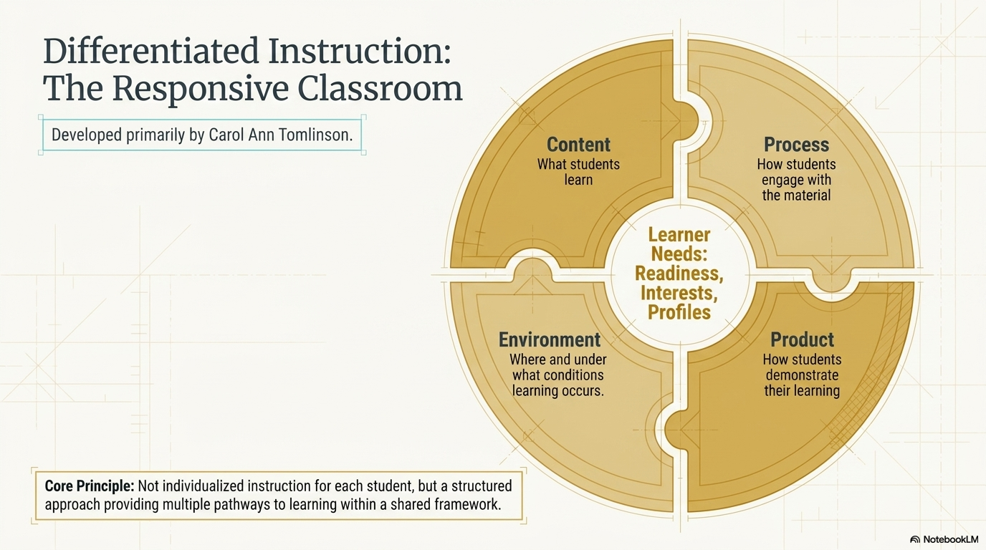

Slide 8
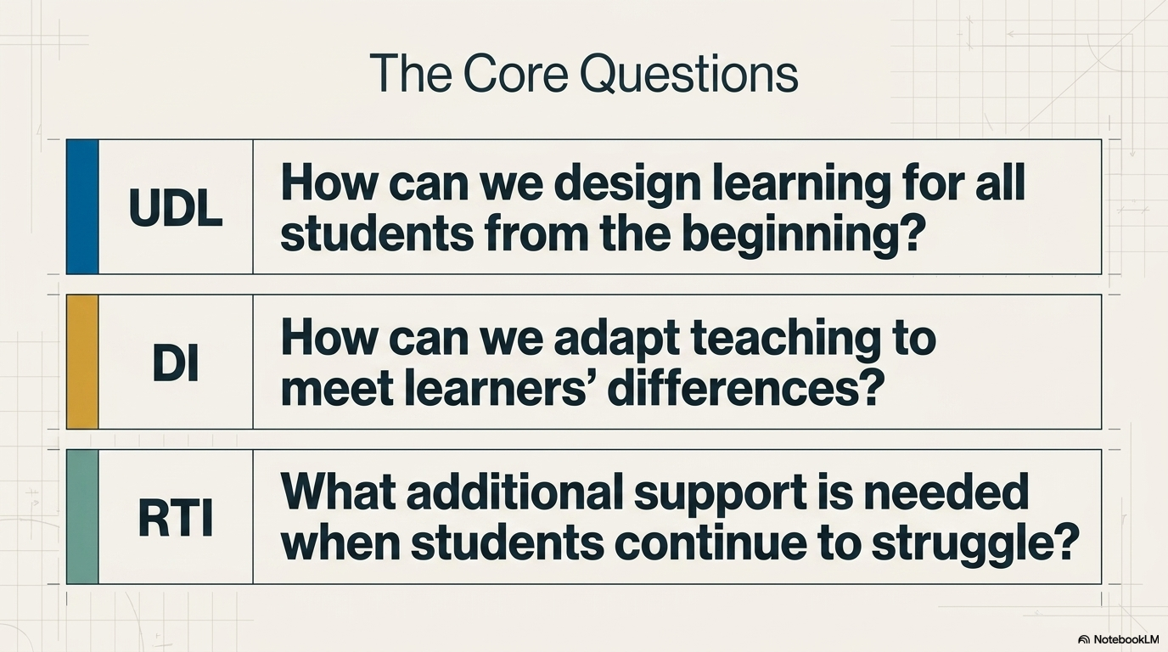

Slide 9
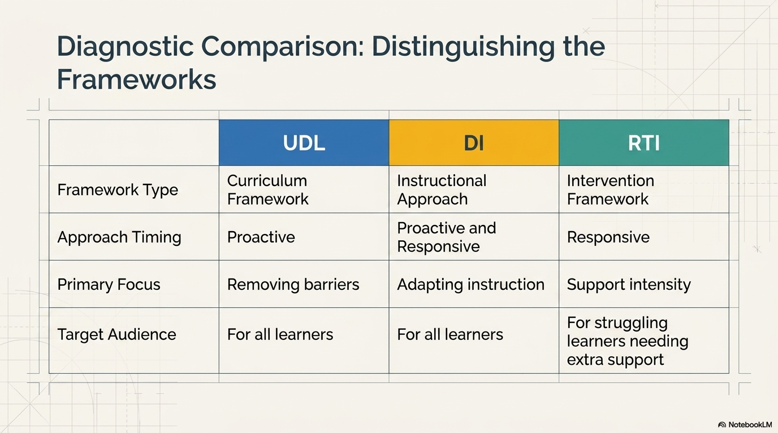

Slide 10


Slide 11
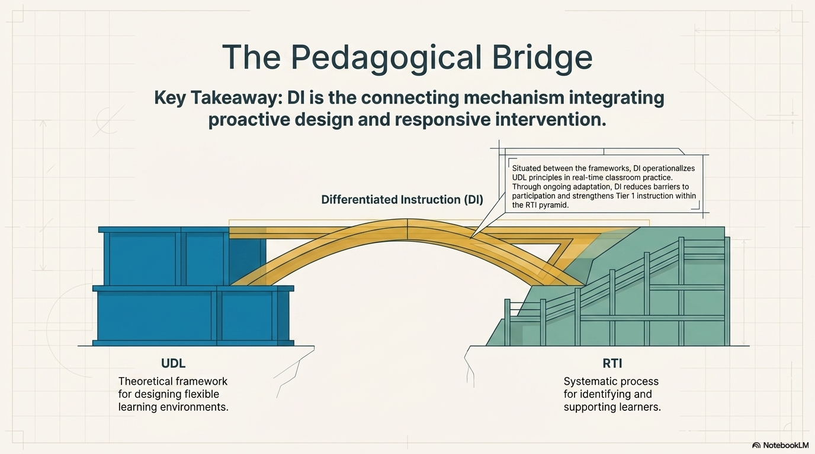

Slide 12
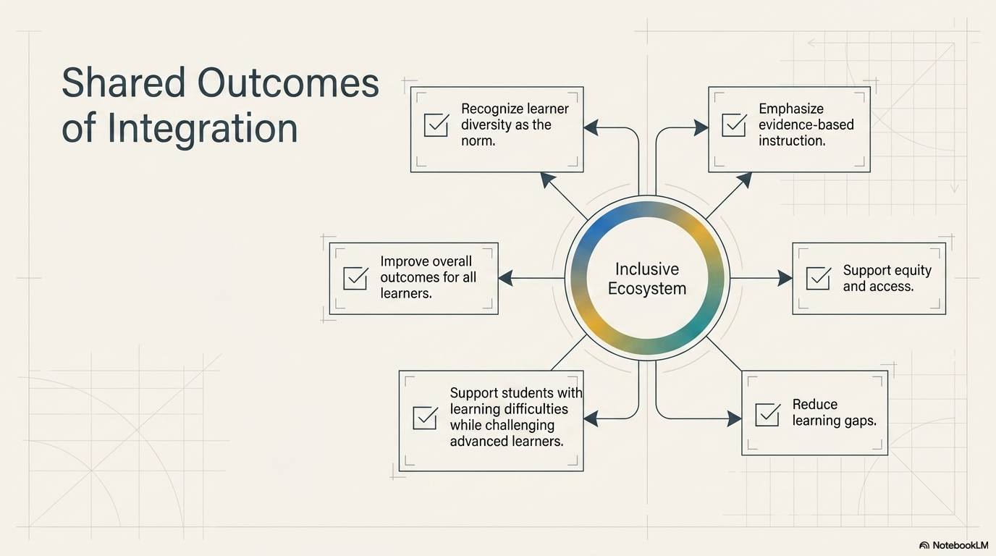

Slide 13
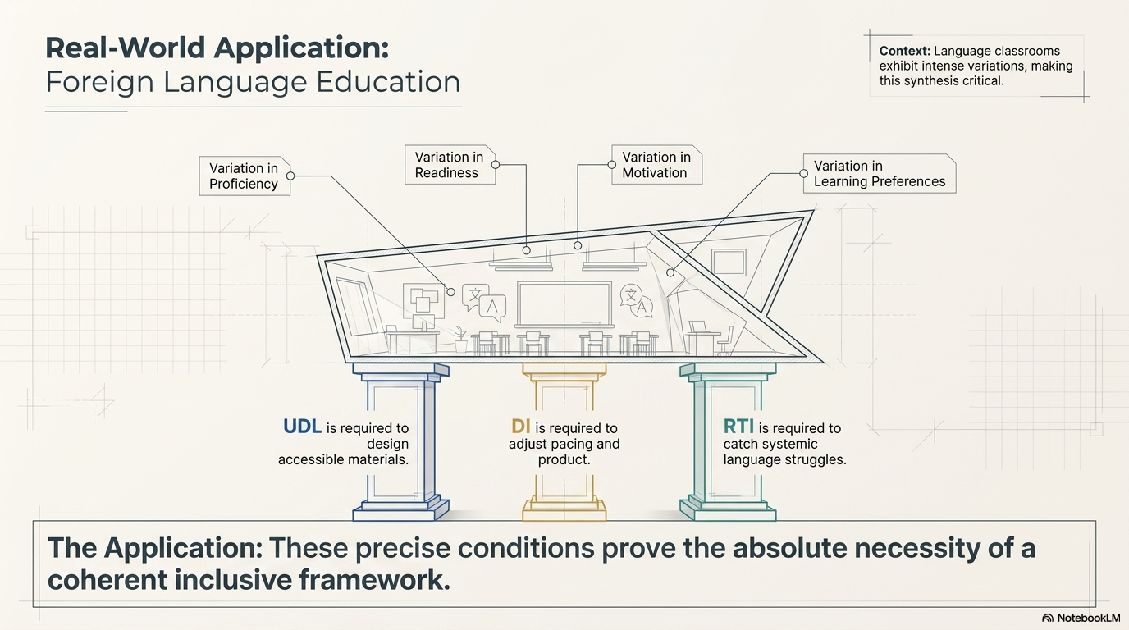

Slide 14
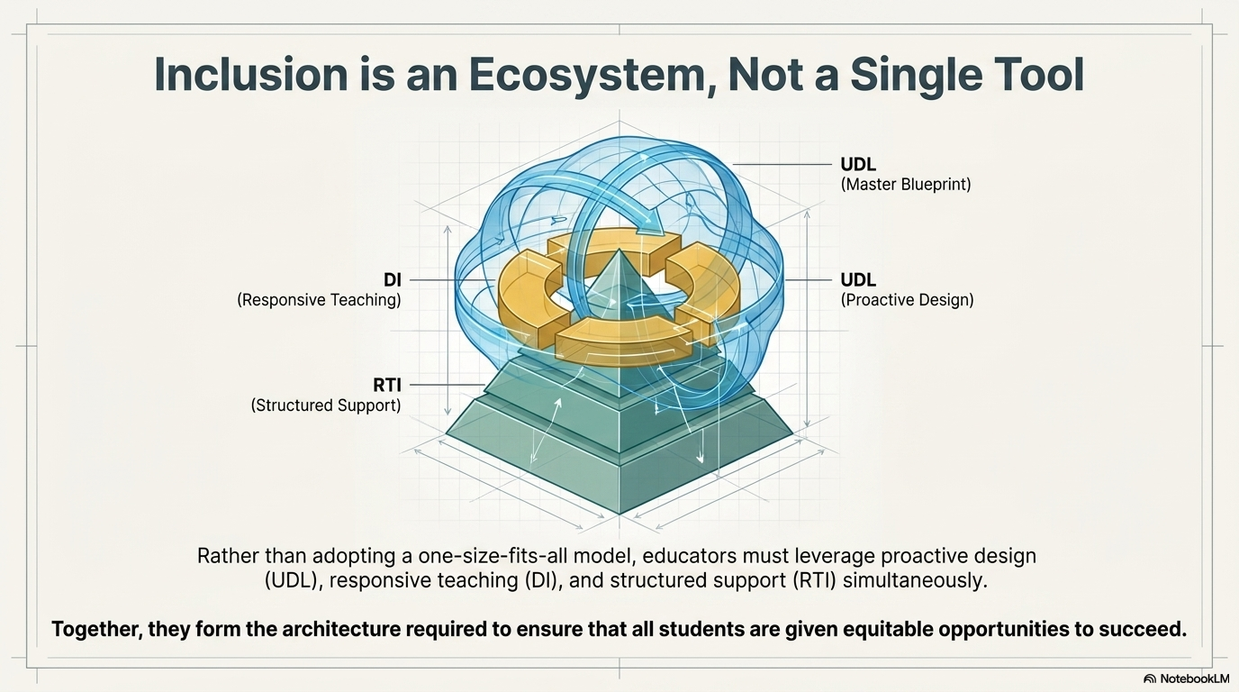

Slide 15
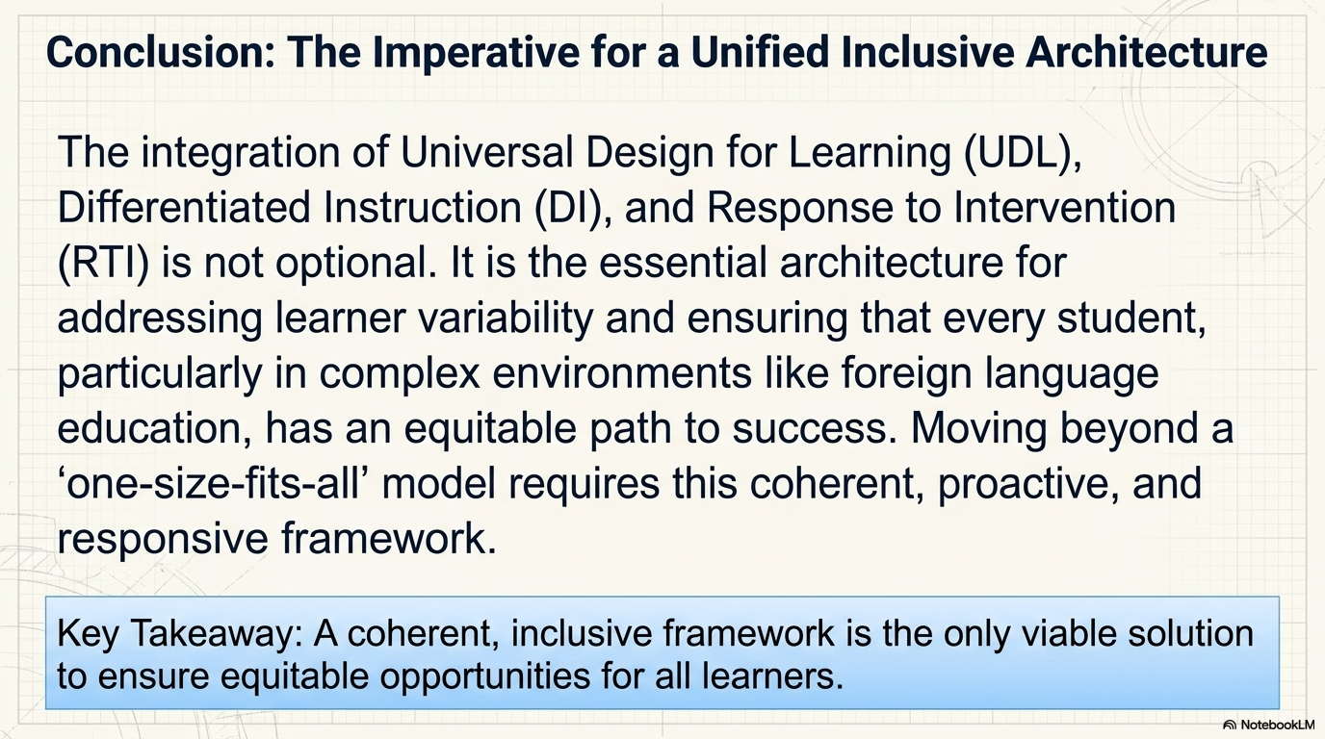

Slide 16
References
Fuchs, D., & Fuchs, L. S. (2006). Introduction to Response to Intervention: What, why, and how valid is it? Reading Research Quarterly, 41(1), 93–99.
Hall, T. E., Meyer, A., & Rose, D. H. (2012).Universal Design for Learning in the Classroom: Practical Applications. Guilford Press.
McGuire, J. M., Scott, S. S., & Shaw, S. F. (2006). [Universal Design for Learning: Ensuring equal access to information].,
Meyer, A., Rose, D. H., & Gordon, D. (2014).Universal Design for Learning: Theory and Practice. CAST Professional Publishing.
Tomlinson, C. A. (2017). [Differentiated Instruction: Addressing learner variability].
Tomlinson, C. A., & Moon, T. R. (2013).Assessment and Student Success in a Differentiated Classroom. ASCD.

