Slide 1

Sustainability Education
TSAPARDONI AIKATERINI
PhD Candidate of University of Alicante

Slide 2
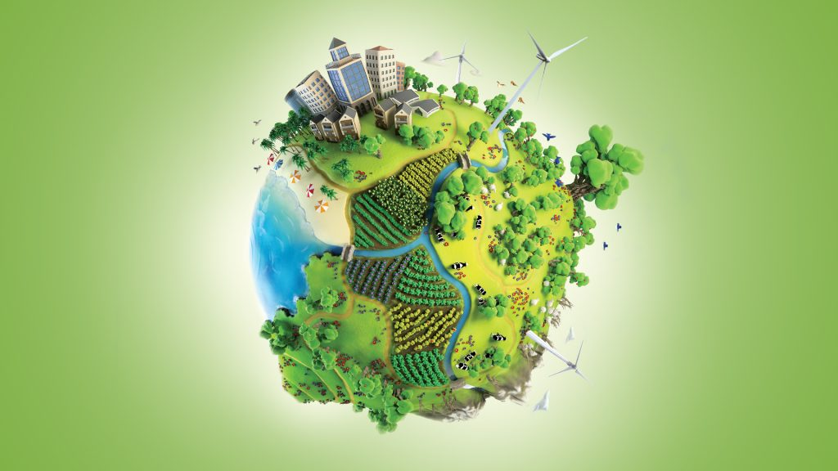
Abstract
This paper, which is a literature review, examines sustainability education and sustainability consciousness. Sustainability education is related to the integration of the principles of sustainable development into teaching, and the cultivation of sustainability consciousness, a concept consisting of values, attitudes, behaviors and actions, which is a basic condition to successfully integrate the goals of sustainable development into the educational process. At the same time, the decisive role of teachers as agents of social change is highlighted and the difficulties and challenges presented in practice are highlighted. Suggestions are also made to strengthen sustainability education, which contributes to promoting a more responsible lifestyle towards the environment and society.

Slide 3
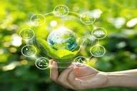
Introduction
The environmental crisis is one of the most important challenges emerging in our time. To protect the planet (from warming, loss of biodiversity, air pollution, reckless consumption of natural resources), to eradicate poverty and for the well-being of all, the United Nations (UN) developed a global plan of action, the goals of sustainable development, addressing education and society, well-being and infrastructure, environment and climate.
In terms of education, the UN speaks of quality education and especially equal education that ensures and promotes lifelong learning opportunities for all. Through educational experiences individuals systematically come into contact with learning, socialization and thus form values, attitudes and behaviors that contribute to the cultivation of sustainability consciousness in education (UNESCO, 2017) and hence urge society towards a better future.

Slide 4

Sustainability education is about integrating the principles of sustainable development into teaching, so that teachers and students cultivate the knowledge, skills and attitudes needed to address emerging environmental and social challenges and achieve a more sustainable future. Also, sustainability education is not limited to imparting information about nature or the risks involved. It focuses on creating a deeper relationship with the environment and society and instilling in individuals a sense of being part of a wider ecosystem, where any positive action gains prestige and value.
Cultivating sustainability consciousness, which is considered a complex concept consisting of related values, attitudes, behaviors and actions, is a basic condition to successfully integrate the goals of sustainable development into the educational process, which emphasize cognitive, social and emotional learning.
In this paper, the decisive role of teachers as agents of social change and the difficulties and challenges presented in practice are highlighted. At the same time, proposals are made to strengthen sustainability education in a way that contributes to and promotes a more responsible lifestyle towards the environment and society.

Slide 5

Objective: The objective of this paper is to highlight the importance of sustainability education and the cultivation of sustainability consciousness.
Sustainability education
Sustainability education relates to the development of knowledge, attitudes and behaviors consistent with the integration of sustainable development principles into educational practice and aims to prepare individuals for a more sustainable life. This kind of education is not limited to imparting knowledge, but focuses on shaping ways to understand, evaluate and act against complex social, environmental and economic challenges (pillars of sustainable development) (UNESCO, 2017). It also tends to contribute to the emotional and social cultivation of students and highlight the importance of learning as a process that shapes values ​​and responsible choices (Gericke et al., 2019; UNESCO, 2020).
Sustainability education creates a strong foundation for a responsible attitude towards nature, develops students' social skills and values, such as respect, responsibility and solidarity, and contributes to their socialization. Through the development of knowledge and the development of emotion and active participation, this education tends to strengthen the general development of students, so that they develop into persons with responsibility and respect for the environment and society.

Slide 6

Sustainability consciousness as a concept
Sustainability consciousness is internationally recognized as the concept that aims to understand how individuals relate to sustainable development, as it captures the level of knowledge, attitudes, behaviors and actions, spanning all three bases of sustainable development: the environment, society and economy (Gericke et al., 2019; Michalos et al., 2012). Also, this concept assimilates a holistic approach to learning that requires emotional involvement and the tendency to be active (Boeve-de Pauw et al., 2015; UNESCO, 2020) and it contributes to the union of knowledge with values ​​and responsible actions (Lezak & Thibodeau, 2016; UNESCO, 2017).
Cultivating sustainability consciousness can be seen as an important educational prerequisite for the effective implementation of education for sustainable development, as there is an immediate potential to transform theoretical knowledge into routine practices and reliable choices.
Emotional and social learning emerges as the basis for enhancing sustainability consciousness, since it is the basis for developing empathy, responsibility, social awareness and sound decision-making. These skills are inextricably linked to active citizenship and help individuals not only to understand the goals of sustainable development, but to act and actively participate in realizing a better future. In this way sustainability consciousness acquires a basic pedagogical orientation (CASEL, 2020).

Slide 7

Didactic approaches
For sustainability education to move from the theoretical framework to educational practice and to be effective, systematic approaches are needed that are experiential and fit, according to UNESCO (2020), into the professional context of teachers.
Approaches that aim to strengthen consciousness about sustainability should be governed by planned pedagogical processes that include, according to Gericke et al. (2019), teachers' reflection, emotional involvement and active action. Following this, teachers should be trained and, through collaborative and experiential methods, be empowered and acquire the disposition for pedagogical innovation.
Teaching approaches that combine sustainability education with emotional and social learning enhance ecologically oriented consciousness. Also, teaching approaches such as experiential learning, emotional empowerment and interdisciplinary integration should be implemented in school. Through approaches that espouse the principles of active engagement and experiential experience, individuals not only become ecologically conscious, but also adopt attitudes that make them capable citizens working for a better future.

Slide 8
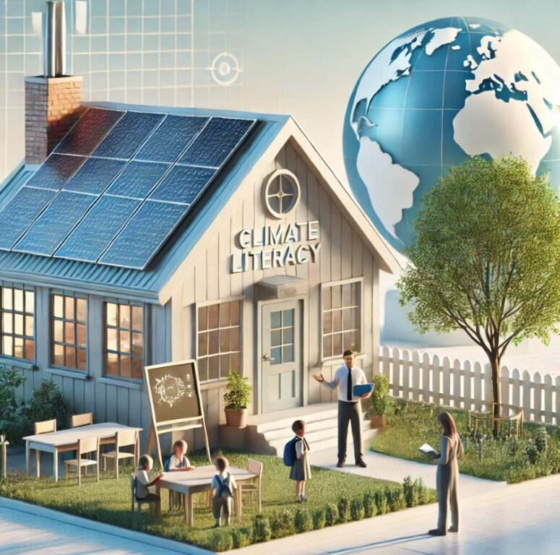
The role of teachers
Teachers, as agents of pedagogical and social transformation, play an important role in education for sustainability. Through learning experiences, attitudes and behaviors that empower reflection, critical thinking and participatory involvement, responsibility and collaboration, but also by making use of everyday life, teachers contribute to translating the goals of sustainable development into pedagogical practices (Mogren et al., 2019). Through actions governed by collective responsibility, teachers can instill in students values ​​that determine the way they perceive society and the environment, integrate ecological values ​​into daily routines and contribute to the cultivation of an active attitude towards the world (Davis, 2015). Also, with their actions, teachers contribute to strengthening the experiential dimension of sustainability education and help students cultivate ecological awareness that will accompany them throughout their lives.

Slide 9

The role of teachers
Teachers also act as connecting links between their educational unit and the local community. The local community can play a key role in empowering sustainability education. Teachers in collaboration with local bodies, municipalities, environmental organizations, strengthen the synergy of those involved. This synergy gives impetus to the cultivation of sustainability values ​​and promotes the effort of the educational process for social transformation and lifestyle change to approach the natural-social environment with a long-term perspective. At the same time, it forms a connecting framework of learning and practice and offers students the possibility to participate in activities with a real impact and to experience ecological responsibility as an integral part of their lives.
Despite the fact that positive attitudes of teachers towards sustainability are observed and their strengthening is a key element for the essential use of education for sustainable development, several authors, like Malandrakis et al. (2019) and Kefalaki (2023), point to the existence of deficiencies in continuous training, pedagogical confidence and supportive structures for teachers to move from the theoretical framework to educational practice.

Slide 10
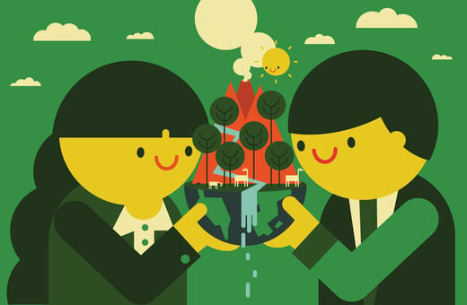
Difficulties and challenges
Despite the importance of sustainability education, its implementation in the educational field often finds obstacles that reduce its effectiveness. These difficulties are related to institutional, pedagogical and practical factors that affect the daily learning process.
One of the most common problems is the lack of enough resources. Many educational units do not have sufficient outdoor spaces to take advantage of ecological activities. Also, the existence of a limited number of materials for ecological programs pushes teachers to resort to improvised solutions.
Sustainability education requires specific knowledge and skills. Several teachers complain about the lack of adequate training in sustainability and experiential approach, which contributes to limiting their confidence to take appropriate actions (Hedefalk et al., 2015). The absence of systematic training programs makes it difficult to implement innovative educational practices.

Slide 11
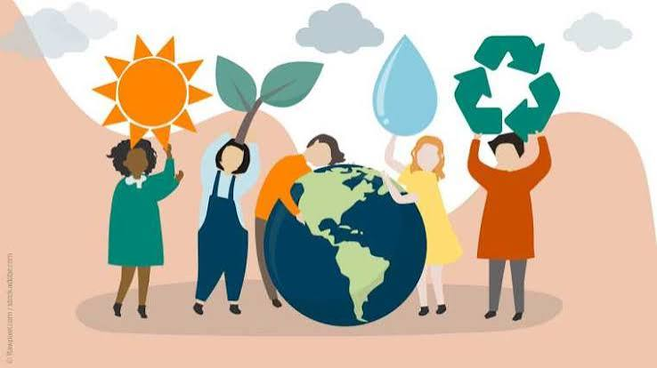
Difficulties and challenges
The attitudes of the local community have a decisive influence on the success of sustainability education. When social practices project consumer standards, the effort of each school unit meets resistance. But also, the absence of cooperation between school and local society is often an obstacle to embedding the values ​​of sustainable development.
In general, the difficulties and challenges of education for sustainability highlight the need for institutional support, adequate resources, systematic training of teachers and active participation of the local community. Through a holistic approach, barriers to sustainability education can be addressed and ecological awareness in the school environment can be supported.

Slide 12

Conclusion
This literature review highlights the result that sustainability education is the foundation for the development of ecological consciousness and the cultivation of a responsible attitude towards nature. By receiving targeted, experiential and structured training, teachers can significantly enhance sustainability awareness as reflected in knowledge, attitudes and behaviors. According to UNESCO (2017), teachers play a pivotal role in enhancing sustainability, social change and the educational process as they shape sustainable practices and culture, both inside and outside the school space. Furthermore, teachers are the connecting links between school and society. With these allies, sustainability education is not limited to the context of the school unit, but extends to the students' daily lives.
Conclusion
This literature review highlights the result that sustainability education is the foundation for the development of ecological consciousness and the cultivation of a responsible attitude towards nature. By receiving targeted, experiential and structured training, teachers can significantly enhance sustainability awareness as reflected in knowledge, attitudes and behaviors. According to UNESCO (2017), teachers play a pivotal role in enhancing sustainability, social change and the educational process as they shape sustainable practices and culture, both inside and outside the school space. Furthermore, teachers are the connecting links between school and society. With these allies, sustainability education is not limited to the context of the school unit, but extends to the students' daily lives.
Sustainability education requires holistic approaches aimed at the professional development of teachers. Educational approaches based on social and emotional learning, experiential learning and active engagement strengthen the behavioral dimension of sustainability consciousness, and help educators translate knowledge and values ​​into intention and action. Studies by Durlak et al. (2015) highlight that approaches based on experiential participation bring about more substantial changes in feelings and behaviors. Research by Mogren et al. (2019), argues that the approaches to be effective must be linked to a more general educational vision and to institutional and organizational support, so that the training affected has a significant impact, is reinforced and diffused throughout the educational community.

Slide 13
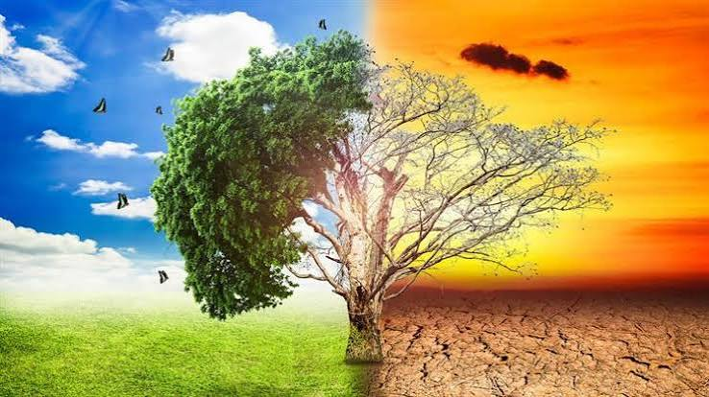
Suggestions
The implementation of sustainability education requires sufficient resources, reinforcement of teacher training, cooperation of the school unit with the local government and ecological agencies and, by extension, continuous support at an institutional and social level.
It is recommended to organize educational policies that put teachers at the center of the transition to more sustainable oriented schools and societies and shape students into future citizens who will be governed by ecological responsibility, social sensitivity and will actively contribute to the development of a sustainable future.
Investing in sustainability education can be an investment in the quality of life of future generations.

Slide 14
References
Boeve-de Pauw, J., Gericke, N., Olsson, D., & Berglund, T. (2015). The effectiveness of education for sustainable development. Sustainability, 7(11), 15693-15717. https://doi.org/10.3390/su71115693
CASEL (2020). CASEL’S SEL Framework: What are the Core Competence Areas and where are they promoted? https://casel.org/casel-sel-framework-11-2020/
Davis, J. (2015). Young children and the environment: Early education for sustainability (2nd ed.). Cambridge University Press.
Durlak, J. A., Domitrovich, C. E., Weissberg, R. P., & Gullotta, T. P. (2015). Handbook of social and emotional learning: Research and practice. Guilford Press.
Gericke, N., Boeve-de Pauw, J., Berglund, T., & Olsson, D. (2019). The sustainability consciousness questionnaire: The theoretical development and empirical validation of an evaluation instrument for stakeholders working with sustainable development. Sustainable Development, 27, 35–49.
Hedefalk, M., Almqvist, J., & Östman, L. (2015). Education for sustainable development in early childhood education: A review of the research literature. Environmental Education Research, 21(7), 975–990.
Kefalaki, M. (2023). Education for sustainable development (ESD) in the Greek education system. Journal of Applied Learning and Teaching, 6(1), 296-305.
Lezak, S. B., & Thibodeau, P. H. (2016). Systems thinking and environmental concern. Journal of Environmental Psychology, 46, 143-153. https://doi.org/10.1016/j.jenvp.2016.04.005
Malandrakis, G., Papadopoulou, P., Gavrilakis, C., & Mogias, A. (2019). An education for sustainable development self-efficacy scale for primary pre-service teachers: construction and validation. Journal of Environmental Education, 50(1), 23-36.
Michalos, A. C., Creech, H., Swayze, N., Kahlke, P. M., Buckler, C., & Rempel, K. (2012). Measuring knowledge, attitudes and behaviors concerning sustainable development among tenth grade students in Manitoba. Social Indicators Research, 106, 213-238. https://doi.org/10.1007/s11205-011-9809-6
Mogren, A., Gericke, N., & Scherp, H.-Å. (2019). Whole school approaches to education for sustainable development: a model that links to school improvement. Environmental Education Research, 25(4), 508-531.
UNESCO (2017). Education for sustainable development goals: Learning objectives. UNESCO.
UNESCO (2020). Education for sustainable development: A roadmap. UNESCO.

Slide 15

THANK YOU FOR YOUR TIME

