Slide 1
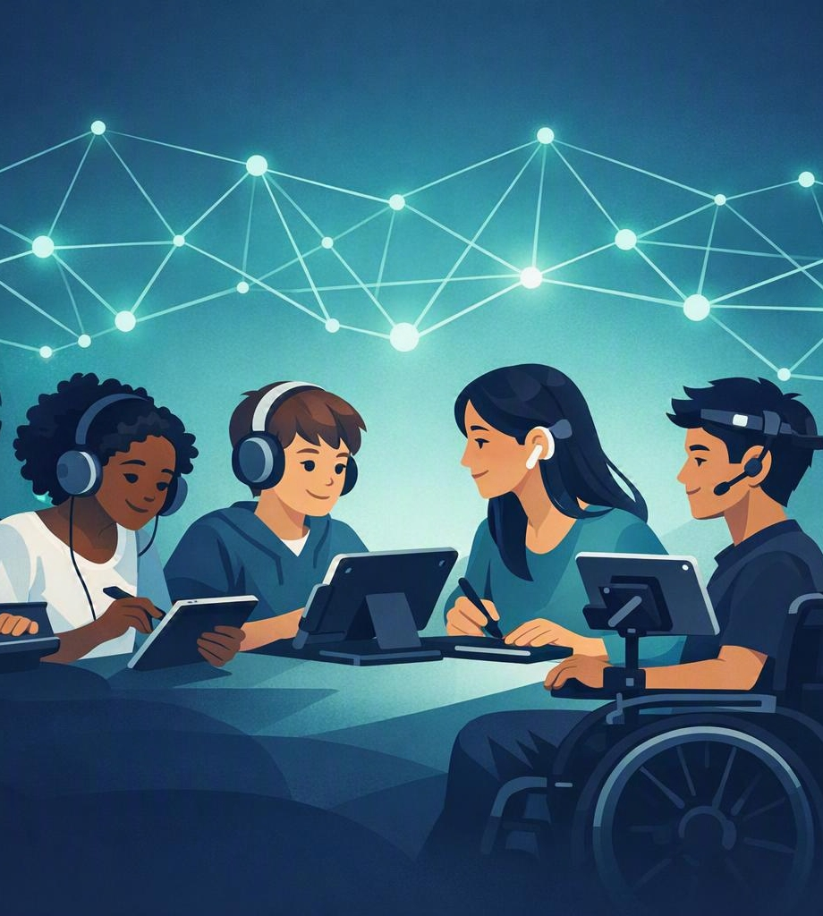
Artificial Intelligence for Inclusive Education
An emerging framework for accessibility, personalization and educational equity
Presenter:
Anastasia Papa
PhD Candidate, University of Murcia
PhD Programme in Educational Technology
Supervisor: Isabel Gutiérrez Porlán

Slide 2
FOUNDATIONS
The Evolution of Inclusive Education
From Integration to Inclusion
Core Principles
Inclusive education has become a central priority in international educational policy, emphasizing equal learning opportunities for all students regardless of their cognitive, sensory, physical or developmental characteristics.
Educational equity
Accessibility and participation
Learner-centered instruction
Diversity as an educational asset
Removal of learning barriers
CURRENT REALITY
Despite significant progress, traditional educational systems continue to face challenges in providing individualized support to learners with diverse educational needs.
Reference: Moriña (2019)

Slide 3
AI IN EDUCATION
Artificial Intelligence: A Transformative Force
Artificial Intelligence is reshaping educational environments through data-driven decision-making and adaptive instructional support.
AI APPLICATIONS IN EDUCATION
Potential Benefits
✓ Intelligent Tutoring Systems
✓ Adaptive Learning Platforms
✓ Automated Assessment
Increased efficiency
Real-time feedback
Personalized instruction
Improved learning outcomes
Enhanced accessibility
✓ Learning Analytics
✓ Recommendation Systems
✓ Generative AI Assistants
References: Miao & Holmes (2023); Shireesha & Jeevan (2024)

Slide 4
LEARNER PROFILES
Students with Special Educational Needs (SEN)
Diverse Learner Profiles
Educational Challenges
Autism Spectrum Disorder (ASD)
Attention Deficit Hyperactivity Disorder (ADHD)
Dyslexia
Intellectual Disabilities
Learning Disabilities
Information processing difficulties
Attention and concentration barriers
Communication challenges
Variability in learning pace
Need for differentiated instruction
EDUCATIONAL GOAL Provide meaningful access to learning through individualized support and accessible instructional design.
Reference: Ahmed et al. (2025)

Slide 5

PERSONALIZATION
Personalized Learning: The Foundation of Inclusion
What is Personalized Learning?
Educational approaches that adapt instruction according to the learner's needs, abilities, preferences and progress.
KEY CHARACTERISTICS
Adaptive pacing
Customized learning pathways
Individualized feedback
Continuous progress monitoring
Learner autonomy
Personalization accommodates learner variability and reduces barriers to participation and achievement.
Adapting instruction to the learner
Reference: Farhood et al. (2025)

Slide 6
FRAMEWORK
Universal Design for Learning (UDL)
The UDL framework proposes that learning environments should be designed to accommodate learner variability from the outset.
1
2
3
Multiple Means of Engagement
Multiple Means of Representation
Multiple Means of Action & Expression
Motivating learners and sustaining participation
Presenting information in multiple formats
Providing alternative ways to demonstrate learning
ULTIMATE GOAL Accessible and equitable learning experiences for all students.
Reference: CAST (2018)

Slide 7
CONCEPTUAL MODEL
A Framework: AI for Inclusive Education
Artificial Intelligence
AI Personalization Mechanisms
Adaptive pacing
Intelligent feedback
Content recommendations
Learning analytics
Automated scaffolding
Personalized Learning Mechanisms
Accessibility & Adaptive Support
Expected Outcomes
Inclusive Learning Environments
Increased engagement
Improved participation
Enhanced accessibility
Better academic achievement
Greater learner autonomy
Learning Outcomes
Reference: Song et al. (2024)

Slide 8
SYSTEMS IN ACTION
AI-Powered Personalized Learning Systems
How do they work? These systems continuously collect and analyze learner’s data to adapt instruction in real time.
1
2
3
4
5
Data Collection
Learner Analysis
Content Adaptation
Personalized Feedback
Progress Monitoring
EXAMPLES
✓ Intelligent Tutoring Systems
✓ Adaptive Learning Platforms
✓ AI Recommendation Systems
✓ Learning Analytics Dashboards
Reference: Farhood et al. (2025)

Slide 9
EVIDENCE BASE
Evidence from Recent Research
Reported benefits of AI for students with SEN
Cognitive Benefits
Behavioral Benefits
Emotional Benefits
Improved academic performance
Better comprehension
Enhanced problem-solving skills
Higher engagement
Increased participation
Greater persistence
Improved self-confidence
Increased autonomy
Reduced learning frustration
RESEARCH TREND Current evidence suggests positive outcomes, although large-scale empirical evaluations remain limited.
References: Ahmed et al. (2025); Wang (2026)

Slide 10
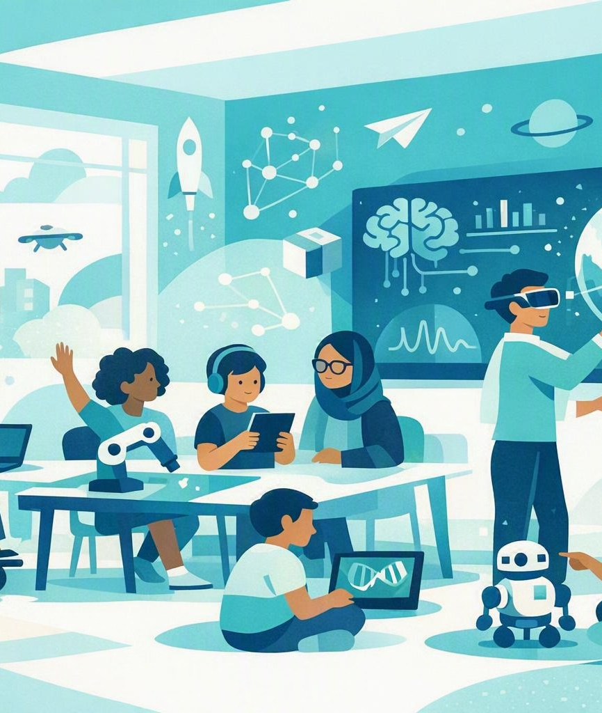
TECHNOLOGY LANDSCAPE
Emerging Technologies Supporting Inclusion
1
Artificial Intelligence Adaptive instructional systems
2
Virtual Reality (VR) Immersive and experiential learning environments
3
Learning Analytics Data-driven identification of learning needs
4
Intelligent Assistive Technologies Tools that improve accessibility and communication
5
Generative AI Personalized support through conversational agents and assistants
References: Chalkiadakis et al. (2024); Khalil et al. (2024)

Slide 11
11
RESPONSIBLE AI
Ethical and Practical Challenges
ETHICAL CONSIDERATIONS
Data Privacy
Algorithmic Bias
Practical Challenges
Protection of sensitive learner information
Avoiding inequitable educational outcomes
Teacher readiness
Digital infrastructure
Accessibility standards
Resource availability
Transparency
Accountability
Understanding AI decision-making processes
Maintaining human oversight
KEY PRINCIPLE Responsible AI should augment human teaching rather than replace it.
Reference: UNESCO (Miao & Holmes, 2023)

Slide 12
HUMAN IN THE LOOP
The Role of Teachers in AI-Supported Learning
Teachers remain central. AI serves as a support tool rather than a substitute for educators.
Teachers Are Responsible For
Factors Influencing Successful Adoption
Instructional design
Inclusive practices
Interpretation of learner data
Emotional and social support
Ethical technology use
Digital competence
Professional development
Positive beliefs about technology
Institutional support
Reference: Ertmer & Ottenbreit-Leftwich (2010)

Slide 13
OUTLOOK
Future Directions and Conclusions
Future Research Priorities
Conclusions
Evaluation of AI effectiveness in SEN contexts
Inclusive AI design frameworks
Ethical implementation models
Longitudinal studies
Human–AI collaboration in education
Artificial Intelligence has significant potential to:
Enhance personalized learning
Improve accessibility
Support inclusive educational practices
Empower students with Special Educational Needs
“The future of inclusive education lies not only in technological innovation, but in the thoughtful integration of AI within pedagogically sound, accessible, and ethical learning environments.”

Slide 14
SOURCES
References
Ahmed, S., Rahman, M. S., Kaiser, M. S., & Hosen, A. S. M. S. (2025). Advancing personalized and inclusive education for students with disability through artificial intelligence: Perspectives, challenges, and opportunities. Digital, 5(2), 11, https://doi.org/10.3390/digital5020011
CAST. (2018). Universal design for learning guidelines version 2.2. http://udlguidelines.cast.org
Chalkiadakis, A., Seremetaki, A., Kanellou, A., Kallishi, M., Morfopoulou, A., Moraitaki, M., & Mastrokoukou, S. (2024). Impact of artificial intelligence and virtual reality on educational inclusion: A systematic review of technologies supporting students with disabilities. Education Sciences, 14(11), 1223.
Ertmer, P. A., & Ottenbreit-Leftwich, A. T. (2010). Teacher technology change: How knowledge, confidence, beliefs, and culture intersect. Journal of Research on Technology in Education, 42(3), 255–284.
Farhood, H., Nyden, M., Beheshti, A., & Muller, S. (2025). Artificial Intelligence-based personalised learning in education: A systematic literature review. Discover Artificial Intelligence, 5(1). https://doi.org/10.1007/s44163-025-00598-x
Khalil, M., Slade, S., & Prinsloo, P. (2024). Learning analytics in support of inclusiveness and disabled students: a systematic review. Journal of Computing in Higher Education, 36(1), 202-219.
AI for Inclusive Education · 14 / 14

Slide 15
SOURCES
References
Miao, F., & Holmes, W. (2023). Guidance for generative AI in education and research. UNESCO. https://doi.org/10.54675/EWZM9535
Moriña, A. (2019). Inclusive education in higher education: challenges and opportunities. Postsecondary educational opportunities for students with special education needs, 3-17.
Shireesha, M., & Jeevan, J. (2024). The Role of Artificial Intelligence in Personalized Learning: A Pathway to Inclusive Education. Library of Progress-Library Science, Information Technology & Computer, 44(3).
Song, Y., Weisberg, L. R., Zhang, S., Tian, X., Boyer, K. E., & Israel, M. (2024). A framework for inclusive AI learning design for diverse learners. Computers and Education: Artificial Intelligence, 6, 100212. https://doi.org/10.1016/j.caeai.2024.100212
Wang, J. (2026). The Impact of Artificial Intelligence-Based Personalized Learning Systems on the Cognitive Ability Enhancement of Children With Special Needs. International Journal of Cognitive Informatics and Natural Intelligence (IJCINI), 20(1), 1-16. https://doi.org/10.4018/IJCINI.397824

