Slide 1
The Medieval Roots of the Mediterranean Diet & Agri-Technology
INTERCULTURAL TRANSFERS IN MEDITERRANEAN EUROPE
KOUVARA ELENI, PHD CANDIDATE
Program: E020 Intercultural and Historical Transfers in the Mediterranean Medieval Europe

Slide 2
Introduction: The Resilient Food System
Definition: Beyond Nutritional Metrics
- The Mediterranean Diet as a dynamic socio-ecological landscape.
The Historical Paradox
- Long-term survival through environmental and political shifts.
Focus on medieval technology as the resilience baseline.

Slide 3
The Medieval Historical Framework
  The Mediterranean as a Fluid Network
    Continuous exchange of agronomic knowledge and botanical species
  Key Vectors of Transfer
    Convergence of Byzantine, Islamic (Al-Andalus) and Christian traditions
    Synthesis of Roman dry-farming and Islamic irrigation science

Slide 4
Agri-Technology I – Water Management
  The Challenge of Aridity
    Adapting agricultural practices to the semi-arid Mediterranean climate
  Islamic Hydraulic Engineering
    Introduction of advanced systems: acequias (channels), norias (water wheels), and qanats
  Institutional Resilience
    Communal water tribunals ensuring equitable distribution and conflict resolution

Slide 5
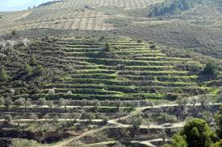
Agri-Technology II – Crop Diversity
Expanding the Mediterranean Triad
  Introduction of citrus fruits, rice, sugar cane and advanced almond cultivation
Soil Preservation Systems
  Construction of stone-walled terraces (bancales) on hillsides to prevent erosion
Ecological Balance
  Utilization of medieval crop rotation systems to maintain soil fertility

Slide 6
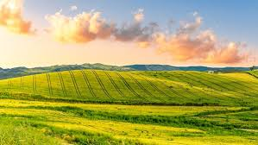
Resilience Then and Now
Historical Shock-Absorbers
How medieval systems survived climate anomalies like the Early Little Ice Age
The Modern Parallel
Traditional ecological knowledge as a blueprint for modern climate adaptation
The Key Takeaway
Shifting from high-energy exploitation to eco-centric technological harmony

Slide 7
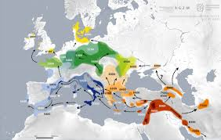
Mapping the Knowledge
The East-to-West Vector
Knowledge flow from the Middle East and Byzantium
to Al-Andalus
Alicante as a Nexus
A strategic regional node for adapting cross-cultural innovations
Landscape Transformation
Transition from Roman dry-farming plots to complex irrigated Huertas

Slide 8
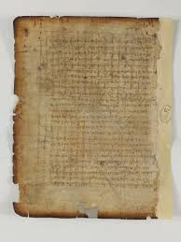
Research Methodology
Archival & Textual Analysis
Examination of medieval agricultural treatises, tax records and water charters
Landscape Archaeology
Field mapping of surviving hydraulic structures (acequias) in the Alicante region
Interdisciplinary Synthesis
Combining historical data with modern agro-ecological and climate records

Slide 9
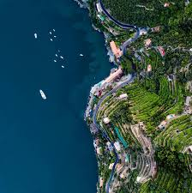
Conclusions
Foundations of Sustainability
Medieval agri-technology created the structural baseline for the modern Mediterranean Diet
Intercultural Value
The resilience of the system is the direct result of historical, cross-cultural knowledge transfers
A Blueprint for the Future
Traditional methods offer scalable solutions for modern climate adaptation and food security

Slide 10
Selected References
  Glick, T. F. (1996). Irrigation and hydraulic technology in medieval Spain. Variorum.
  Trillo San José, C. (2004). Water management and agricultural landscape in Al-Andalus. Brill.
  Watson, A. M. (1983). Agricultural innovation in the early Islamic world: The diffusion of crops and farming techniques, 700–1100. Cambridge University Press.
  Willett, W., Rockström, J., Loken, B., Springmann, M., Lang, T., Vermeulen, S., Garnett, T., Tilman, D., DeClerck, F., Wood, A., Jonell, M., Clark, M., Springmann, M., & Murray, C. J. L. (2019). Food in the Anthropocene: The EAT–Lancet Commission on healthy diets from sustainable food systems. The Lancet, 393(10170), 447–492.

Slide 11

Thank You & Digital Q&A
Virtual Q&A & Discussion
Please leave your questions or comments in the
conference platform platform/chat.
Contact Information
Email: ek93@alu.ua.es
University of Alicante | Department of Medieval Europe

