Slide 1
From Rewilding to AI-Supported Environmental Decision Making
Enhancing an Open Schooling Scenario for Ecosystem Stability
Eleni Korakaki
Doctoral Student, University of Murcia, Spain
International Online Symposium
La Nucía, Spain
2026

Slide 2
Why Ecosystem Restoration Matters
Biodiversity loss is one of the major environmental challenges of our time.
Species extinction affects:
• ecosystem stability
• food webs
• biodiversity
• ecosystem services
Students need opportunities to engage with authentic environmental challenges and develop evidence-based decision-making skills.

Slide 3
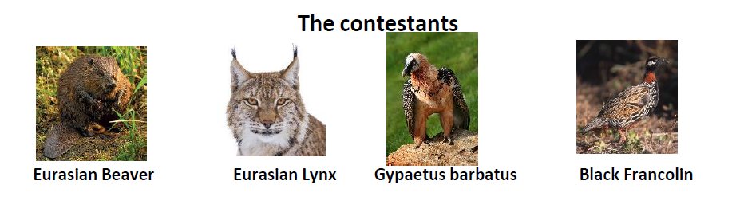

The Original Open Schooling Scenario
The learning scenario was implemented within the European CONNECT, Open Schooling project.
Students explored a real-world environmental challenge:
“Which species could best support the rewilding of a Greek ecosystem?”
Scientists from the Natural History Museum of Crete proposed four candidate species:
Students investigated scientific evidence before making decisions.

Slide 4
The Open Schooling Approach
CARE | KNOW | DO
Students discuss the problem with their families. | Students learn: • ecosystem stability • food webs • ecological interactions • scientific reasoning | Students design a campaign supporting the reintroduction of a species.
Stakeholders: Students
Teachers
Families
Scientists

Slide 5
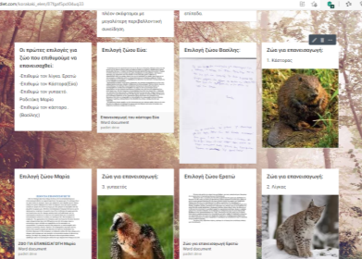
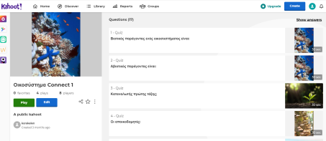
Digital Tools Used During the Implementation
Students used:
• Google Forms (voting)
• Padlet (argumentation)
• Kahoot (self-assessment)
• Mentimeter (feedback)
• Coggle (brainstorming)
• videos and digital resources

Slide 6
The results
The combination of Open Schooling and digital tools helped students analyse evidence, justify their choices and revise their decisions based on scientific reasoning.
Students revised their decisions after applying the scientific method and evaluating ecological evidence.

Slide 7

Why do we need AI if digital tools already work?

Slide 8
The New Educational Challenge
Students increasingly use AI-generated information in their everyday lives.
Key questions:
Can AI support environmental decision-making?
Can students critically evaluate AI-generated claims?
How can AI complement scientific reasoning without replacing it?
Our goal is not to replace experts or scientific evidence, but to use AI as a cognitive tool that supports inquiry, reflection and evidence-based environmental decision making.

Slide 9
Proposed AI Integration
The original Open Schooling framework remains unchanged.
CARE → KNOW → DO
AI is introduced as an additional cognitive tool.
Stage | AI Support
CARE | AI-generated perspectives
KNOW | AI-assisted inquiry
DO | AI-supported campaign design

Slide 10
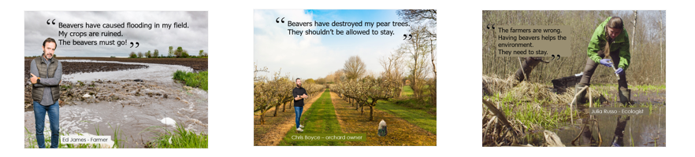
AI Stakeholder Simulation
Students interact with AI-generated stakeholders:
Farmer
Ecologist
Local Community Representative
Environmental NGO
Students compare:
arguments
concerns
priorities
Goal:
Understanding multiple perspectives before making environmental decisions.

Slide 11
AI Fact-Checking Activity
Students examine AI-generated claims using:
scientific resources
classroom materials
expert guidance
Example:
AI Claim:
Reintroducing lynx will automatically increase biodiversity.
Student Task:
Find supporting evidence
Identify limitations
Discuss uncertainty
Goal:
Develop critical AI literacy skills.

Slide 12
AI-Supported Campaign Creation
Students use AI to:
generate slogans
improve campaign texts
design awareness materials
prepare presentations
The final decision and scientific justification remain the responsibility of the students.

Slide 13
From Digital Literacy to AI Literacy
Digital Tools | AI Tools
Google Forms | ChatGPT
Padlet | AI Stakeholders
Kahoot | AI Fact-checking
Mentimeter | AI Reflection
Coggle | AI-supported brainstorming
The goal is not replacement but enrichment.

Slide 14
Expected Learning Gains
Students develop:
scientific reasoning
evidence evaluation
environmental literacy
argumentation skills
AI literacy
critical thinking
responsible use of AI

Slide 15
Challenges
Accuracy of AI-generated information
Risk of misinformation
Need for fact-checking
Teacher guidance
Ethical use of AI
Key principle:
Human judgment remains essential.

Slide 16
Future Implementation & Conclusions
This proposal extends an Open Schooling scenario that has already demonstrated positive educational outcomes.
Artificial Intelligence can:
✓ enrich inquiry
✓ support reflection
✓ strengthen argumentation
✓ promote AI literacy
AI should support, not replace, scientific inquiry and evidence-based environmental decision making.
Future classroom implementations will investigate how AI can support environmental decision making while maintaining scientific rigor and evidence-based reasoning.

Slide 17
This presentation proposes an AI-enhanced extension of a previously implemented Open Schooling scenario on ecosystem stability.
Thank you

Slide 18
Bibliography
Korakaki, E., Apostolakakis, A., & Georgoulakis, E. (2023). Ecosystem Stability Using Open Schooling Methodology. DOI: 10.5281/zenodo.10142863.
Okada, A. (2023). Inclusive Open Schooling with Engaging and Future-Oriented Science.
Okada, A., & Gray, P. (2023). A Climate Change and Sustainability Education Movement: Networks, Open Schooling and the CARE-KNOW-DO Framework. Sustainability, 15(3).
UNESCO (2023). Guidance for Generative AI in Education and Research.
https://connect-science.net/
Some illustrations were generated using AI tools for educational and presentation purposes.

