Slide 1




EFL Textbooks in the Digital Age
Eleni Paraskeva
PhD student of University of Alicante

Slide 2

Background
  ICT plays a crucial role in modern language education.
  ICT supports digital literacy, multimodal learning, and engagement.
  Textbooks should reflect digital literacy.

Slide 3
Aim of the study
  To examine ICT integration
  Identify ICT- related elements
  Explore their pedagogical role

Slide 4
Research Questions
  What ICT elements are included?
  How are they used?
  What is their pedagogical value?

Slide 5
Methodology
  Qualitative content analysis.
  English textbook (Grade A – Senior High School)
  Four coding categories

Slide 6
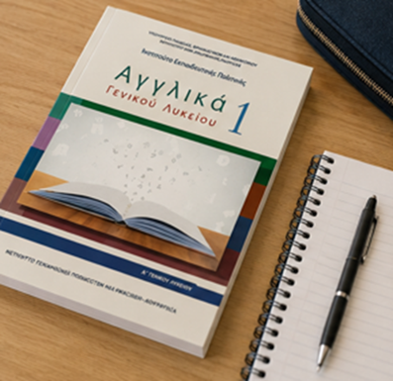

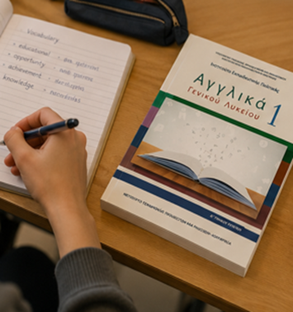
Findings
  Authentic Digital Resources
  Multimedia Learning
  Information and Digital Literacy
  Social Media Unit

Slide 7

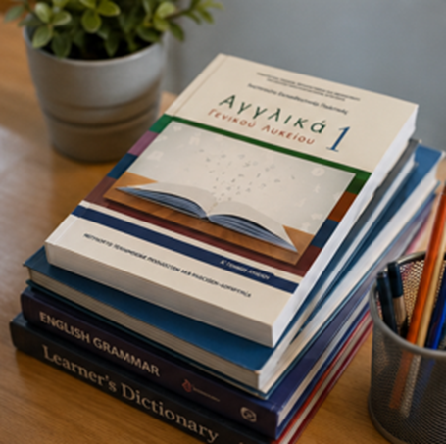
Authentic Digital Resources
  BBC
  The Guardian
  The Telegraph
  Wikipedia
  WordReference
  SparkNotes

Slide 8


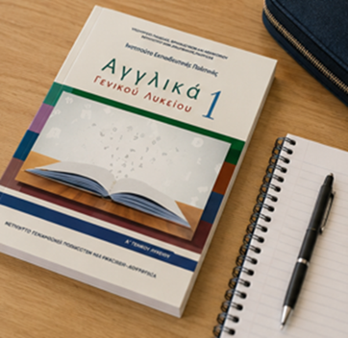
Multimedia Learning
  TED Talks
  BBC Videos
  YouTube
  National Geographic
  Audio materials

Slide 9

Information and Digital Literacy
  Students learn to:
  search online
  use digital dictionaries
  retrieve information
  explore authentic sources

Slide 10
Digital Content Creation
  Students create:
  Digital posters
  Presentations
  Interactive images
  Digital stories
  Digital tools include:
  Poster Creator
  Tour Builder
  Google Earth

Slide 11

Social Media Unit
  Most explicit ICT-related content.
  Focus on digital communication and well-being.
  Encourages critical digital literacy.

Slide 12
Discussion
  The textbook promotes:
  ✔ Authentic learning
  ✔ Multimedia learning
  ✔ Digital literacy
  ✔ Learner autonomy
  ✔ Critical digital literacy

Slide 13
Recommendations
  More digital creation activities
  Stronger critical digital literacy
  Updated digital resources
  Teacher professional development

Slide 14

Conclusions
  ICT is embedded in communicative activities.
  ICT is integrated throughout the textbook.
  Technology supports language learning.
  The Social Media unit is the strongest example of ICT integration.
  The textbook contributes to learners' digital competence.

Slide 15

Thank you!!

