Slide 1

A Critical Discourse Analysis of Patriarchal Hegemony in the Greek Digital Press
(2021–2026)
Dr. Olga Panou

Slide 2
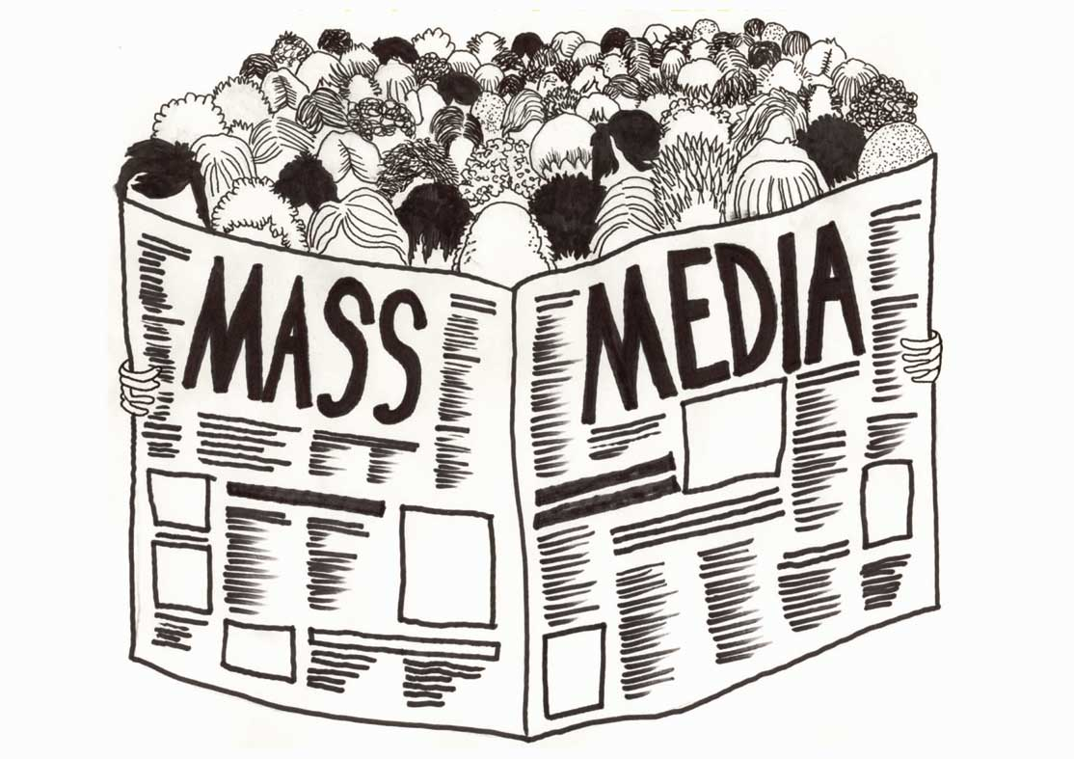
Research framework
Journalistic discourse is not merely a record, but a mechanism for producing social reality
The media framing of femicides functions as a systematic reproduction of patriarchal structures
The phenomenon of gender-based violence is frequently depoliticized through media narratives

Slide 3
Theoretical background
The research adopts Fairclough’s (1995) three-dimensional model defining language as a social practice
Contemporary Research
Aldrete et al. (2023) emphasize the role of the media as arenas of ideological reproduction, noting that the representation of crime depends directly on the medium in question
Studies by Apospori (2022) and Georgiou (2024) highlight the convergence of digital discourse and gendered power, observing that although the term “femicide” is entering the public lexicon, the interpretation of the phenomenon as a “family tragedy” remains dominant
Kafourou (2021) emphasizes the need for critical literacy in representations of violence
Papaspyros (2022) analyzes how specific incidents (such as the Glyka Nera case) are exploited to construct gender identities

Slide 4

Fairclough’s 3D Model
Textual: Linguistic features
Discursive: Production & consumption
Social: Broader power relations

Slide 5
Methodological Framework
Approach
Critical Discourse Analysis (CDA) method was selected and applied to a sample of recent digital publications
Goal
Move beyond descriptive narrative to structural coding and develop a "Patriarchal Codebook" to link specific media framing choices with institutional outcomes

Slide 6
Research gap & Contribution
The Gap
A lack of standardized coding schemes in Greek academia for the study of digital discourse
Contribution
A shift from descriptive narrative to structural coding and the establishment of a “Patriarchal Codebook” to link media framing with institutional inaction

Slide 7
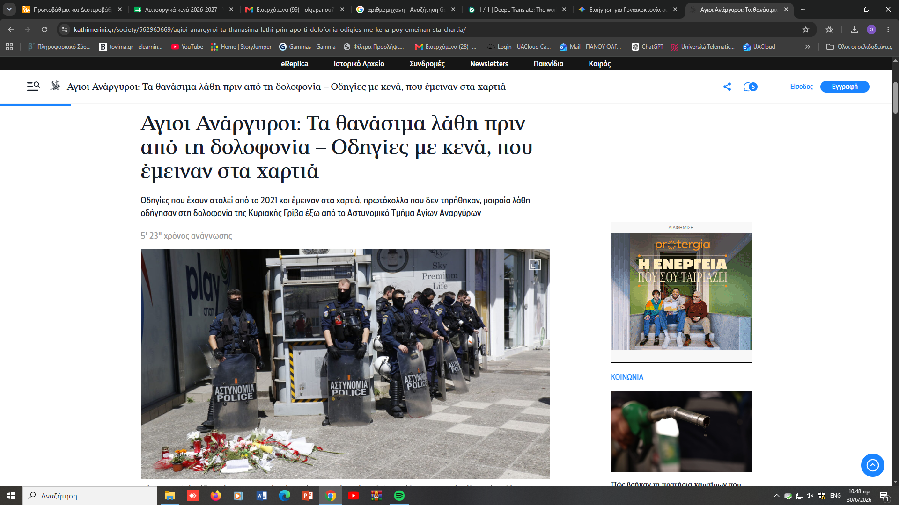
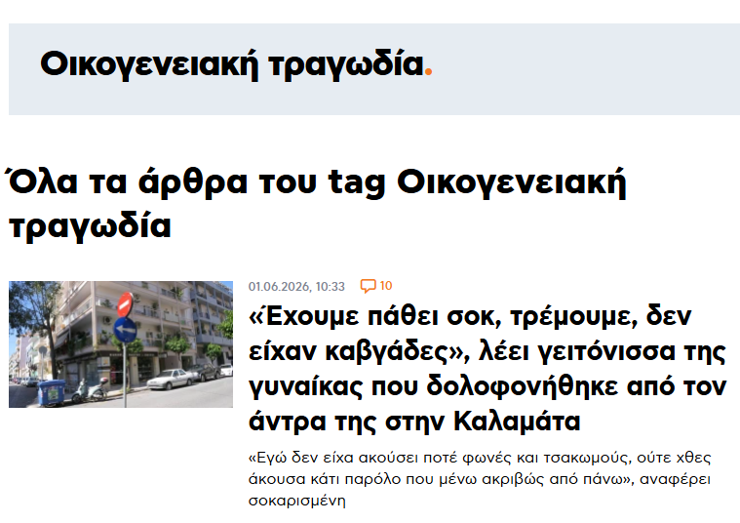
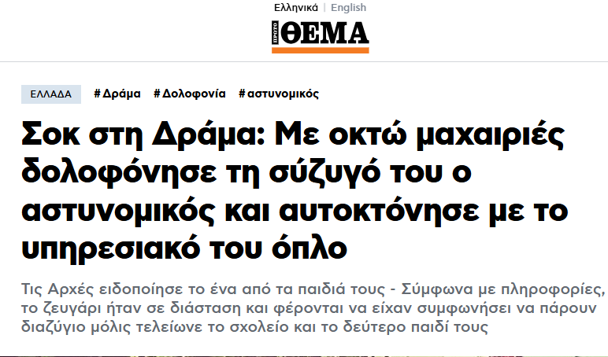
Sample
Selection of 10 cases (2021–2026) from prominent digital media outlets, chosen for their high institutional significance and reach in the Greek digital press

Slide 8
Discursive Mechanisms
Patriarchal Media Phrase | Sociological Reality
"Crime of passion" | Femicide
"Family drama" | Gender-based violence
"He lost his mind" | Exercise of absolute control and power
"An argument that got out of hand" | Unilateral lethal assault
"He couldn't handle the rejection" | Violation of the right to self-determination
"Quiet family man" | Concealment of abuse

Slide 9
Discursive strategies
Privatization
Use of the term “Family Tragedy” to isolate the incident
Humanization
Highlighting the perpetrator’s professional attributes to legitimize his actions in the eyes of society
Pathologization
Attributing violence to momentary instability or medical causes
Victim Blaming
Shifting responsibility through narratives of mutual conflict

Slide 10
Case Study I– Folegandros (2021)
Findings
“Crime of Passion”
Semiotic Alibi
The romanticization of possessiveness neutralizes the murderous intent

Slide 11
Case Study II – Rethymno / Salamina (2023)
Findings
“Blackout,” “Blind Jealousy”
Semiotic Alibi
Medicalization of violence to absolve the perpetrator of responsibility

Slide 12
Case Study III– Agioi Anargyroi (2024)
Findings
Systemic failure rather than patriarchal responsibility
Semiotic Alibi
The focus on police negligence transforms the crime into an administrative error

Slide 13
Case Study IV– Drama (2026)
Findings
“Head of the Family,” “Police Officer”
Semiotic Alibi
The perpetrator’s social status serves as a guarantee of moral integrity

Slide 14
Summary of Case Studies
Agioi Anargyroi (2024)
Focus on police negligence as an “administrative error” rather than patriarchal responsibility
Folegandros (2021)
Romanticization of possessiveness in the context of a “crime of passion”
Drama (2026)
The perpetrator’s social status (“head of the household”) as evidence of moral integrity
Rethymno / Salamina (2023)
Medicalization of violence through terms such as “blackout” or “blind jealousy”

Slide 15
Discussion
The media create an ideological safety zone for the state by focusing on the individual rather than the structural roots of violence
A critical finding of this research is the interdiscursive link between media narratives and legal proceedings: the 'family tragedy' frame is effectively weaponized within the courtroom, often serving to mitigate sentencing by obscuring the systemic nature of patriarchal violence

Slide 16
Recommendations
Editorial Reframing
Shift from narrative, event-based reporting to structural analysis of gender-based violence
Critical Literacy
Institutionalize gender equality protocols and CDA training within journalism curricula

Slide 17
Conclusion
Language is not neutral; it is the blueprint of our collective ethics
Deconstructing the discourse that presents femicide as a “fatal tragedy” is an imperative ethical act

Slide 18
Thank you for your attention

