Slide 1
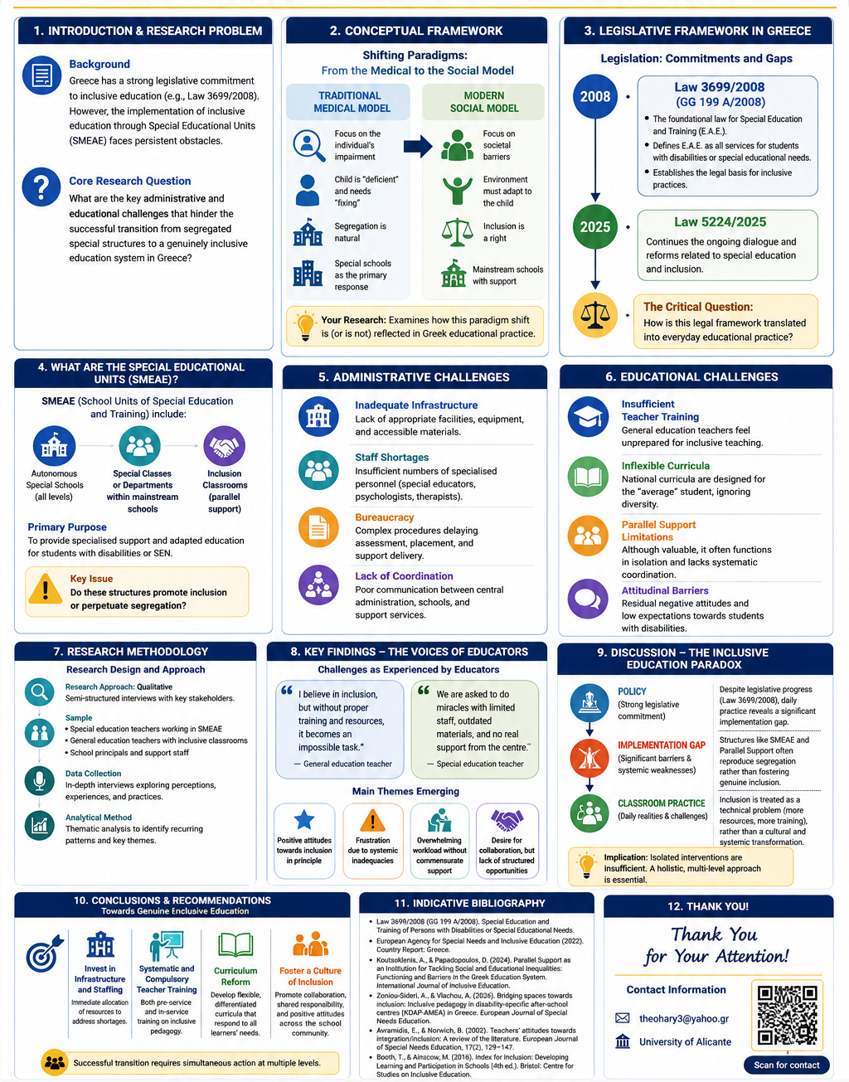
Transitioning from Segregated Special Units to Inclusive Classrooms in Greece
Vasiliki Theochari
Name Candidate
PhD Candidate at the University of Alicante

