Slide 1

Assessment
in Multicultural Education
Phd Candidate: Arsenia Anagnou
University of Alicante, Spain
July,2026

Slide 2
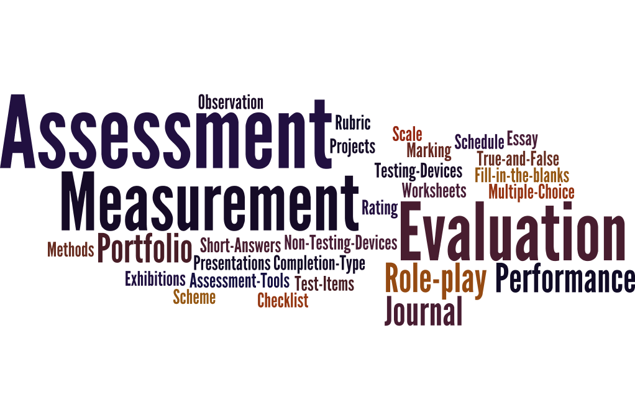
Why Does Assessment Matter In Multilingual Classrooms?
Multicultural education involves learners using more than one language in learning.
Assessment is often challenging because language can affect performance.
Traditional tests may not reflect true student ability
This proposal explores fair and inclusive assessment strategies
(Earl, 2003)

Slide 3
Challenges Of Assessing Multilingual Learners
Language proficiency often affects academic performance
Standardized assessments may not reflect true understanding
Students with limited language skills are unfairly evaluated
Lack of consistency in multilingual assessment practices
Need for valid, reliable, and equitable assessment tools
(Cummins, 2021)

Slide 4
Theoretical Framework
Author(s) | Theory / Framework | Application to Multilingual Assessment
Earl (2003) | Assessment of, for, and as Learning | Assessment should support learning through formative feedback, self-assessment, and summative evaluation.
Black & Wiliam (1998) | Formative Assessment | Continuous feedback improves teaching and learning, helping multilingual learners progress.
Cummins (2008) | BICS & CALP | Assessment should distinguish between conversational language proficiency and academic language proficiency to avoid underestimating learners' knowledge.
García & Wei (2014; 2021) | Translanguaging Theory | Learners should be allowed to use their full linguistic repertoire to demonstrate understanding across languages.
Ontario Ministry of Education (2008) | Differentiated Assessment for ELLs | Assessment should include scaffolding, observation, interviews, portfolios, and multiple sources of evidence.
Council of Europe (2020) | CEFR Companion Volume | Introduces descriptors for plurilingual competence, mediation, and communicative language assessment.
UNESCO (2024) | Classroom-Based Assessment for Multilingual Learners | Promotes equitable, culturally responsive, and linguistically inclusive assessment practices that integrate language, literacy, and content learning.

Slide 5
Principles Of Multilingual Assessment
Key principles
Fairness and equity
Linguistic responsiveness
Validity and reliability
Continuous assessment
Student-centred learning
Multiple sources of evidence
Cultural responsiveness
Formative feedback
(García & Wei, 2014)

Slide 6
Concept Of Assessment
Assessment
Screening/
identification
Placement
Reclassification/exit
Accountability
Program evaluation
Monitoring
Student
Progress
6 verbs of Assessment
(Ontario Ministry of Education, 2008)

Slide 7
Assessment To Understand, Decode And Support:
UNESCO (2024)
Equity & Inclusion
│
(Formative) Black & Wiliam ───► Multilingual Assessment ◄── García & Wei (Translaguaging)
│
Cummins (Academic Language)
│
Ontario (ELL Assessment) │ CEFR (2020)

Slide 8
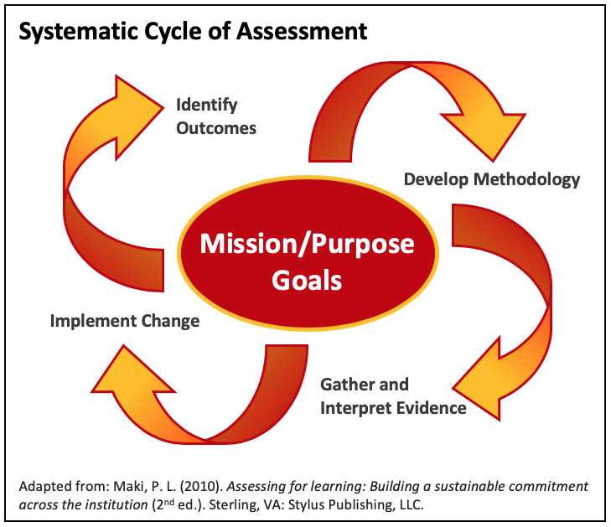
Assessment Methods And Classroom Practices
Instead of only testing language, assess students through:
Classroom observation
Learning portfolios
Oral presentations
Projects
Performance tasks
Peer assessment
Self-assessment
Digital assessment
Rubrics
Conferences with students
(UNESCO,2024)

Slide 9
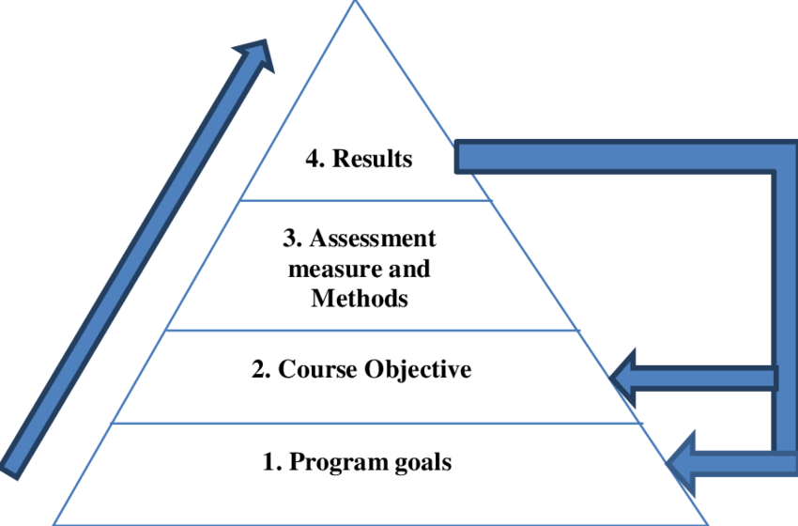
Assessment Of Learning
Achievement Goals
Knowledge and Understanding
Thinking
Communication
Application
(García & Wei, 2021)

Slide 10
Background & Context
Growing linguistic diversity in classrooms worldwide
Increased number of English Language Learners (ELLs)
Shift from monolingual to multilingual pedagogy
Need for fair assessment systems that reflect real learning
Policy emphasis on equity and inclusion
(Cummins, 2008
;Council of Europe, 2020)

Slide 11
Challenges
Teacher workload in designing assessments
Unequal access to technology
Need for teacher training in multilingual pedagogy
Risk of inconsistent grading without strong rubrics
(Black & Wiliam 1998; Cummins 2008)

Slide 12
Conclusions
Multilingual assessment must be inclusive, flexible, and fair
PPT-based assessment provides a strong multimodal solution
Aligns with global shifts toward equity in education
Supports both language development and academic achievement
(Black & Wiliam 1998; Cummins 2008)

Slide 13
References
Paul Black, P., & Dylan Wiliam, D. (1998). Assessment and classroom learning. Assessment in Education: Principles, Policy & Practice, 5(1), 7–74. https://doi.org/10.1080/0969595980050102
Jim Cummins, J. (2008). BICS and CALP: Empirical and theoretical status of the distinction. In B. Street & N. H. Hornberger (Eds.), Encyclopedia of Language and Education (2nd ed., Vol. 2, pp. 71–83). Springer.
Jim Cummins, J. (2021). Rethinking the education of multilingual learners: A critical analysis of theoretical concepts. Language Teaching, 54(3), 1–17. (Use this only if it is the article you consulted; otherwise cite the specific Cummins work you actually use.)
Larry Earl, L. (2003). Assessment as learning: Using classroom assessment to maximize student learning. Corwin Press.
Ofelia García, O., & Li Wei. (2014). Translanguaging: Language, bilingualism and education. Palgrave Macmillan.
Ofelia García, O., & Li Wei. (2021). Translanguaging as a practical theory of language. Applied Linguistics, 42(6), 1031–1052. https://doi.org/10.1093/applin/amab029
Ontario Ministry of Education. (2008). Supporting English language learners with limited prior schooling: A practical guide for Ontario educators, Grades 3–12. Ontario Ministry of Education.
Council of Europe. (2020). Common European Framework of Reference for Languages: Learning, teaching, assessment – Companion volume. Council of Europe Publishing.
UNESCO. (2024). Guidance on classroom-based assessment for multilingual learners: Assessing languages, literacies and content learning. UNESCO.

