Slide 1
Artificial Intelligence, Sustainable Development, and Active Digital Citizenship in Education

Slide 2
Introduction
Sustainable development has been a global priority since the publication of the Brundtland Report, Our Common Future (World Commission on Environment and Development, 1987).
Artificial Intelligence (AI) is rapidly transforming education, society, and governance (Russell & Norvig, 2021).
Sustainable Development Goals (SDGs) require innovative and inclusive solutions (United Nations, 2024).
Active citizenship is increasingly shaped by digital participation and technological literacy (UNESCO, 2024).

Slide 3
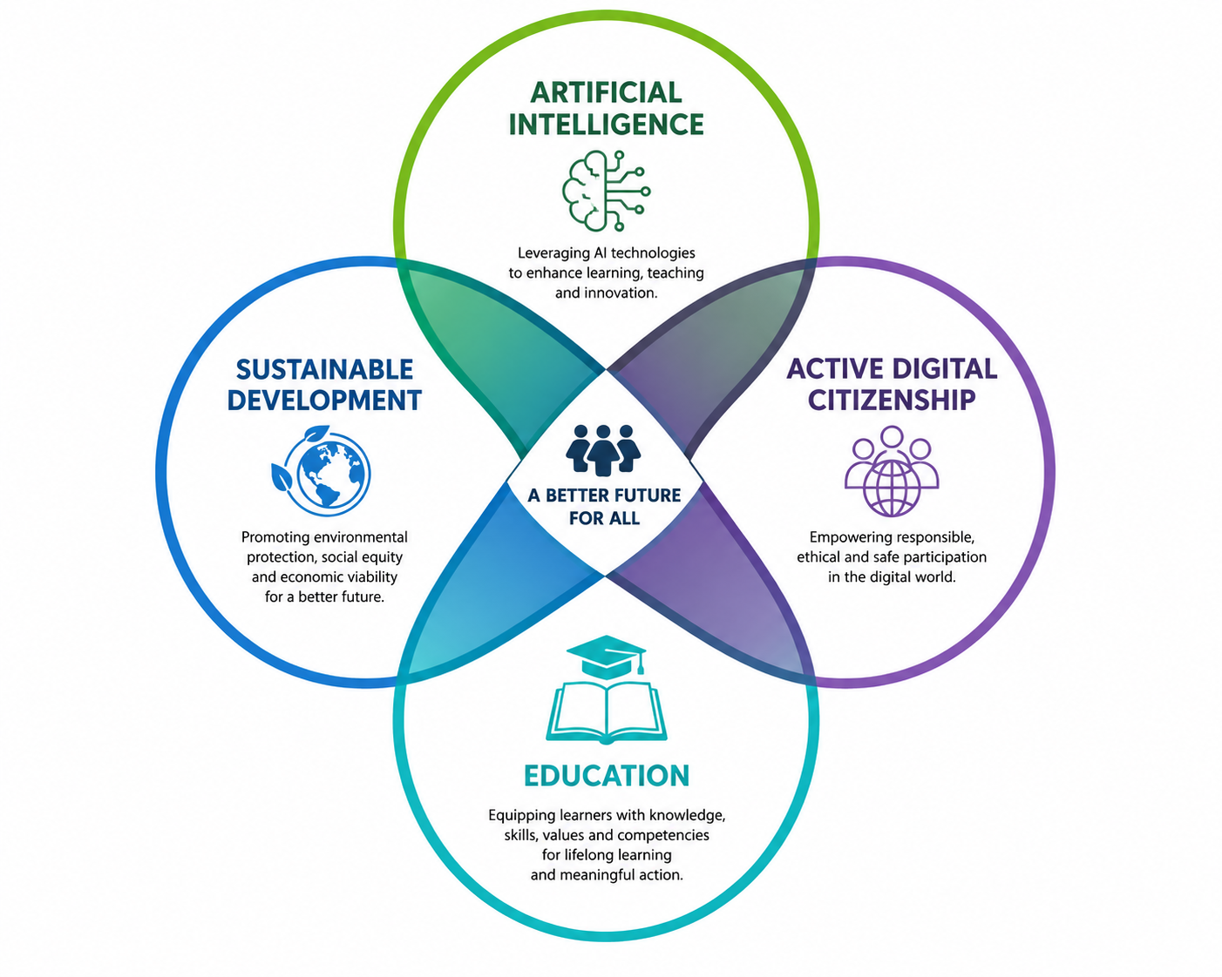
Proposed Conceptual Framework
Education connects Artificial Intelligence, Sustainable Development and Active Digital Citizenship.
Source: Conceptual framework developed by the author based on Floridi (2023), Vinuesa et al. (2020), UNESCO (2024), and Okada et al. (2025).

Slide 4
Artificial Intelligence in Education
Personalized learning experiences.
Learning analytics and adaptive assessment.
Intelligent tutoring systems.
Enhanced accessibility and inclusion.
(Okada et al., 2025; UNESCO, 2024)

Slide 5
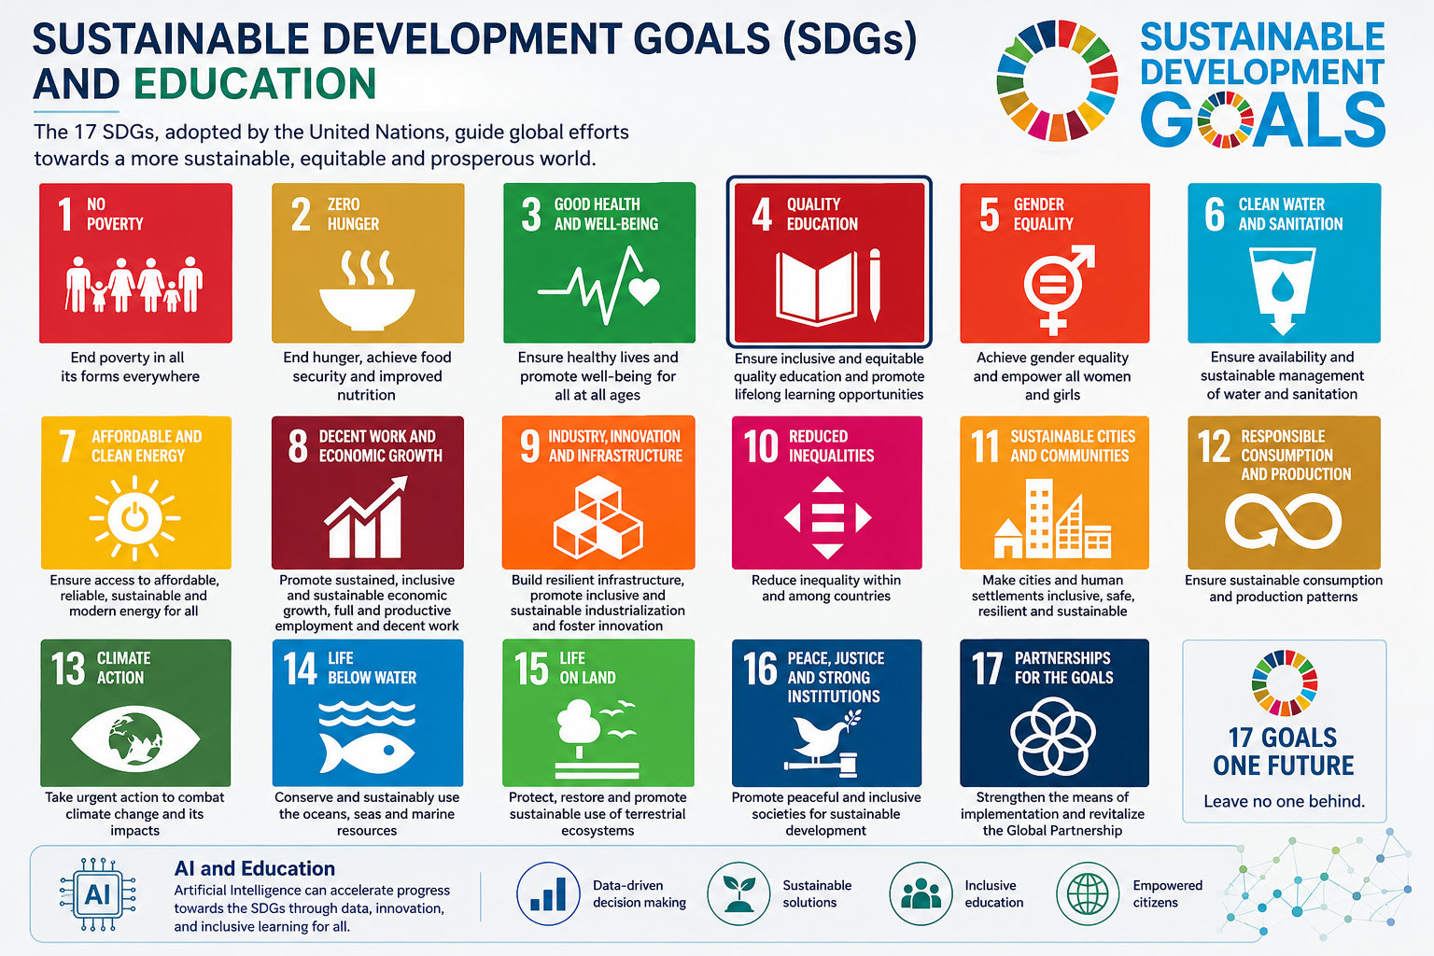
Sustainable Development Goals and Education
Source: United Nations (2015). 2030 Agenda for Sustainable Development (SDGs)

Slide 6
AI as an Enabler of Sustainable Development
Data-driven decision making.
Resource optimization.
Environmental monitoring.
Climate change prediction.
Sustainable urban development.
(Jha et al., 2023; Vinuesa et al., 2020)

Slide 7
Digital Citizenship in the AI Era
Core Competencies
Critical thinking.
Digital literacy.
Ethical technology use.
Civic participation.
Media and information literacy.
Students must learn not only how to use AI but also how to evaluate and govern its use responsibly.
(UNESCO, 2024; Floridi, 2023)

Slide 8
Opportunities for Education
Increased access to knowledge.
Personalized support for diverse learners.
Improved educational equity.
Enhanced collaboration and participation.
Promotion of global citizenship competencies.
(Okada et al., 2025)

Slide 9
Challenges and Risks
Algorithmic bias.
Privacy and data protection concerns.
Digital inequalities.
Misinformation and disinformation.
(Floridi, 2023)

Slide 10
Ethical AI in Education
Principles
Transparency.
Accountability.
Fairness.
Inclusiveness.
Human oversight.
(Floridi, 2023; UNESCO, 2024)

Slide 11
AI and Environmental Awareness
Educational applications can support:
Climate literacy.
Environmental data analysis.
Citizen science initiatives.
(Vinuesa et al., 2020)

Slide 12
Towards Active Digital Citizenship
Students should be empowered to:
Participate in democratic processes.
Engage in evidence-based decision making.
Critically evaluate AI-generated information.
(UNESCO, 2024; Okada et al., 2025)

Slide 13
Implications for Educational Policy
Recommendations
Integrate AI literacy into curricula.
Strengthen citizenship education.
Invest in teacher professional development.
(UNESCO, 2024; Okada et al., 2025)

Slide 14
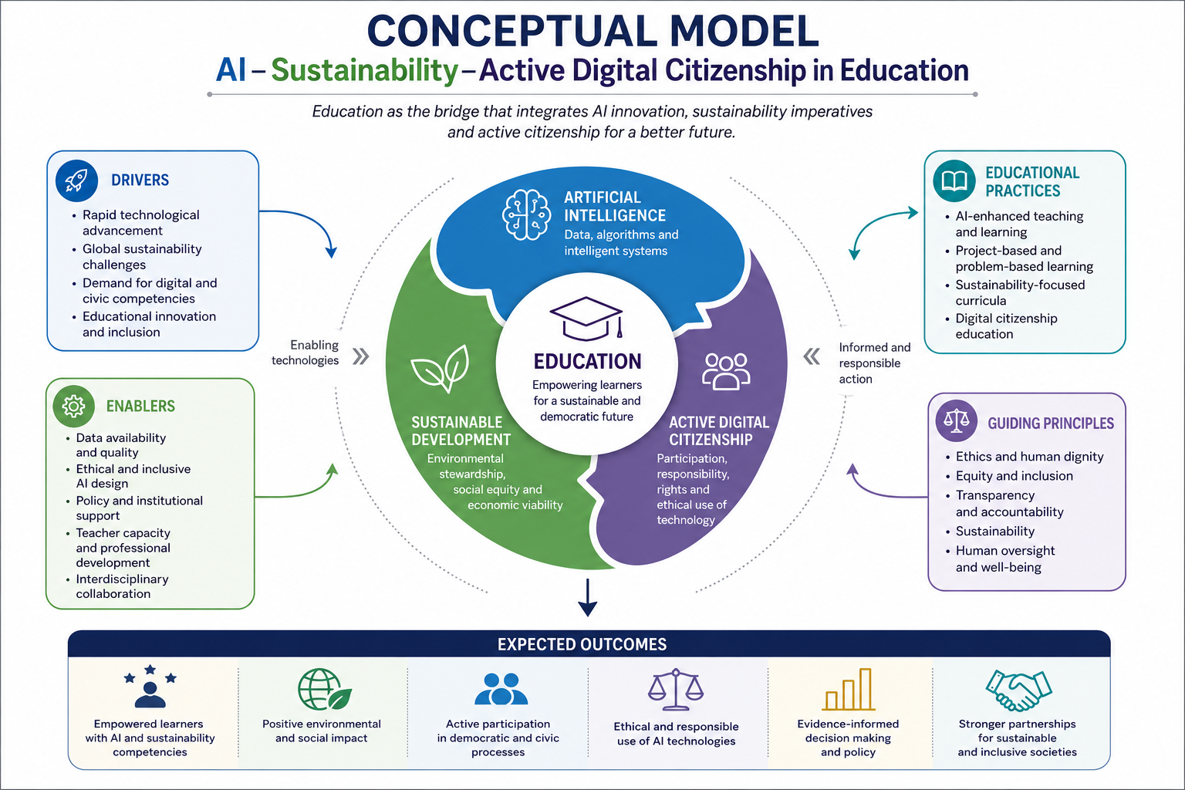
Proposed Integrated Conceptual Model for AI, Sustainable Development and Active Digital Citizenship in Education
Source: Conceptual model developed by the author based on Floridi (2023), Vinuesa et al. (2020), UNESCO (2024), Jha et al. (2023), and Okada et al. (2025).

Slide 15
References
Floridi, L. (2023). The ethics of artificial intelligence for the sustainable development goals. Springer.
Jha, S. K., Jha, A. K., & Gupta, M. P. (2023). Artificial intelligence and sustainable development goals nexus via four vantage points. Technology in Society, 72, 102171. https://doi.org/10.1016/j.techsoc.2022.102171
Okada, A., Sherborne, T., Panselinas, G., & Kolionis, G. (2025). Fostering transversal skills through open schooling supported by the CARE KNOW DO pedagogical model and the UNESCO AI Competencies Framework. International Journal of Artificial Intelligence in Education, 35(4), 1953–1998. https://doi.org/10.1007/s40593-025-00458-w
Russell, S., & Norvig, P. (2021). Artificial intelligence: A modern approach (4th ed.). Pearson.
UNESCO. (2024). Artificial intelligence competency frameworks for students and teachers.
Vinuesa, R., Azizpour, H., Leite, I., Balaam, M., Dignum, V., Domisch, S., Felländer, A., Langhans, S. D., Tegmark, M., & Fuso Nerini, F. (2020). The role of artificial intelligence in achieving the Sustainable Development Goals. Nature Communications, 11(233). https://doi.org/10.1038/s41467-019-14108-y
United Nations. (2015). Transforming our world: The 2030 Agenda for Sustainable Development.
Acknowledgement
The conceptual framework presented in this study was developed through the synthesis of contemporary literature on Artificial Intelligence, Sustainable Development, and Digital Citizenship.

